Slide 1

From Scared to Prepared:
How a school in East Texas became Firewise

Slide 2

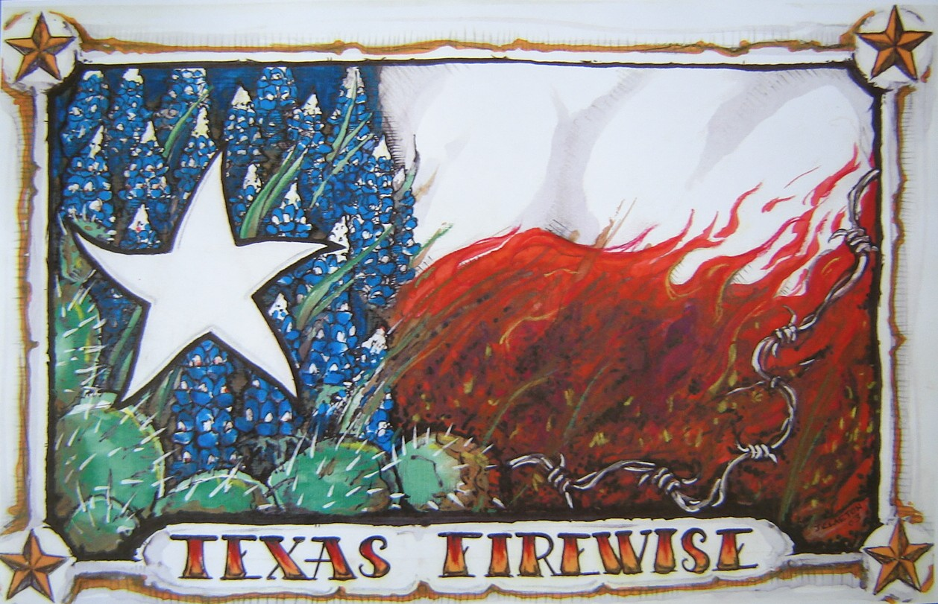

Slide 3
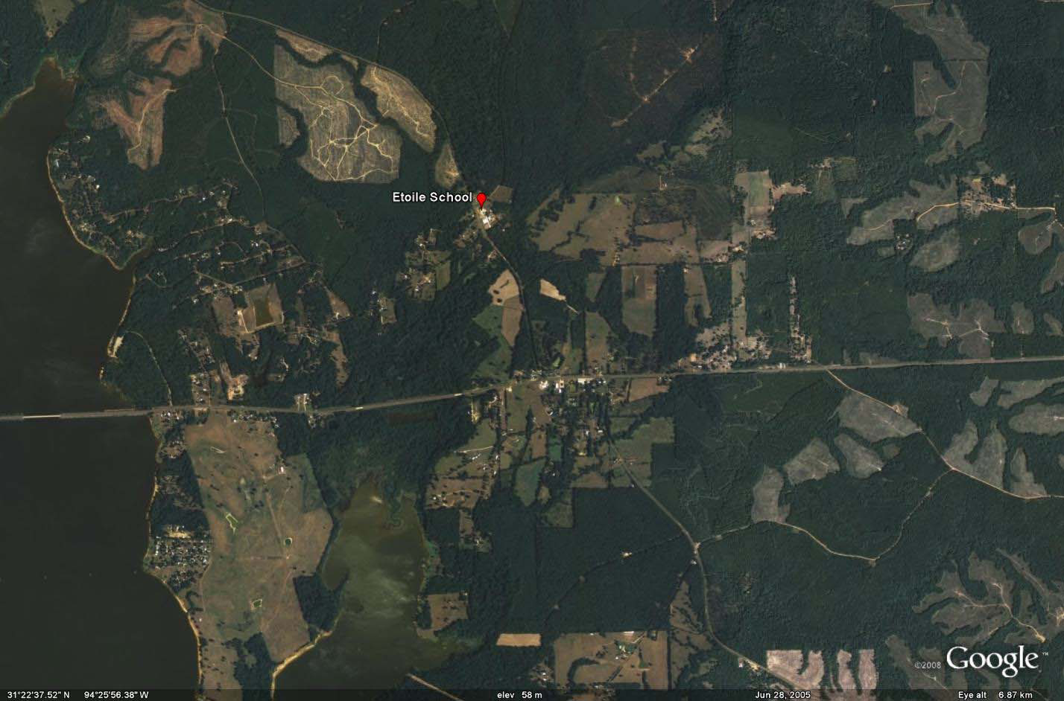
Where in the world is Etoile?
Hwy 103 to Louisiana ~30 minutes
Hwy 103 to Lufkin ~30 minutes
Lake
Sam
Rayburn

Slide 4
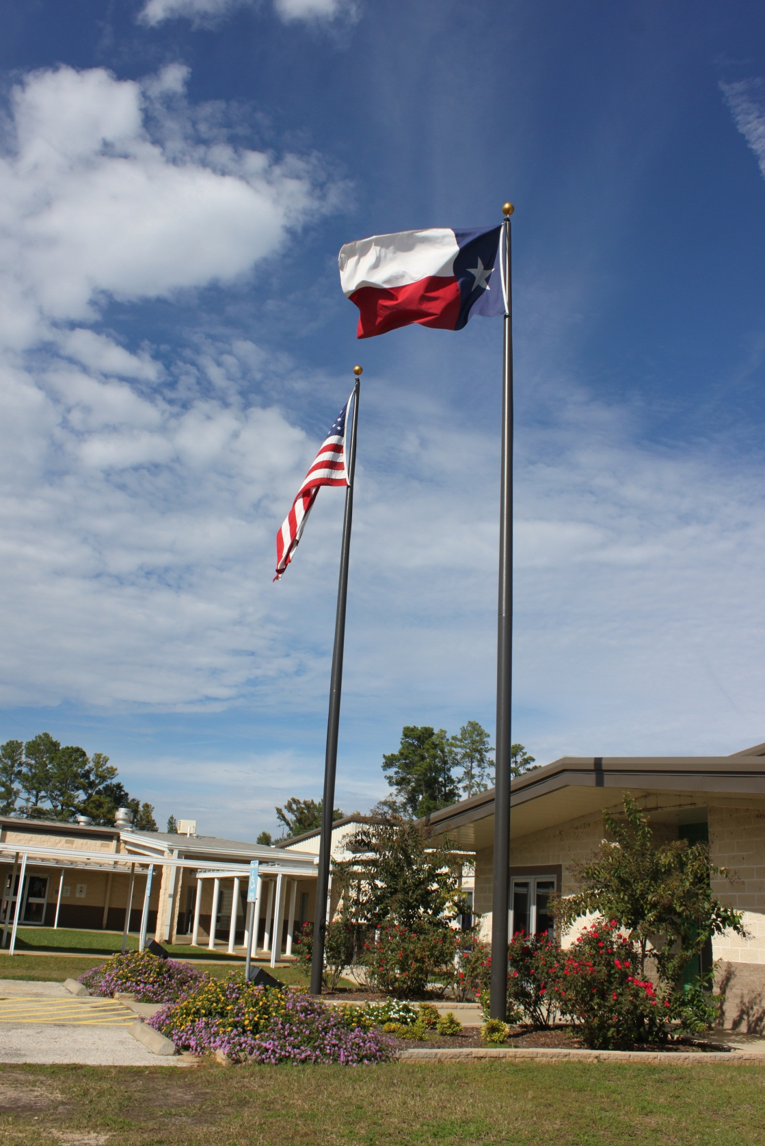
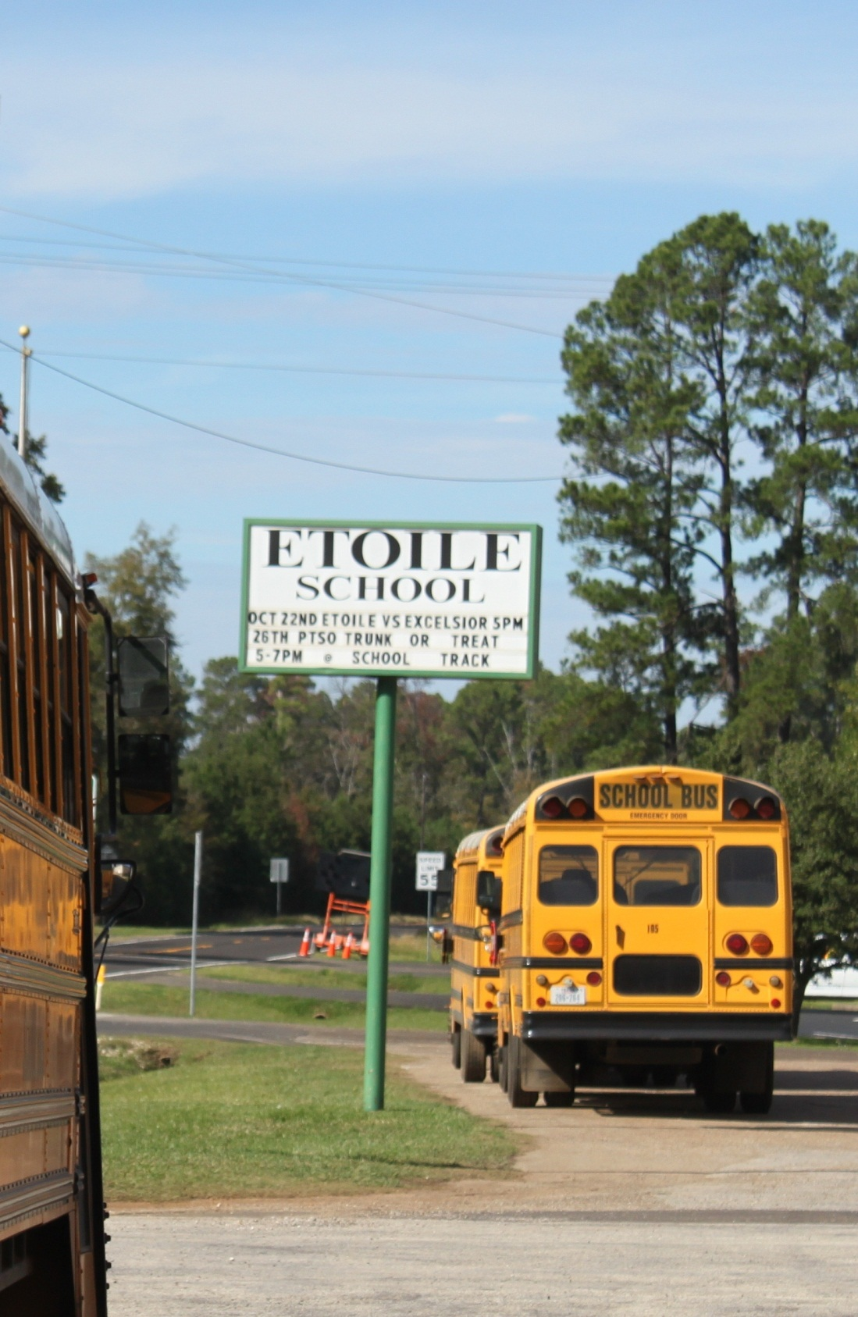

Slide 5
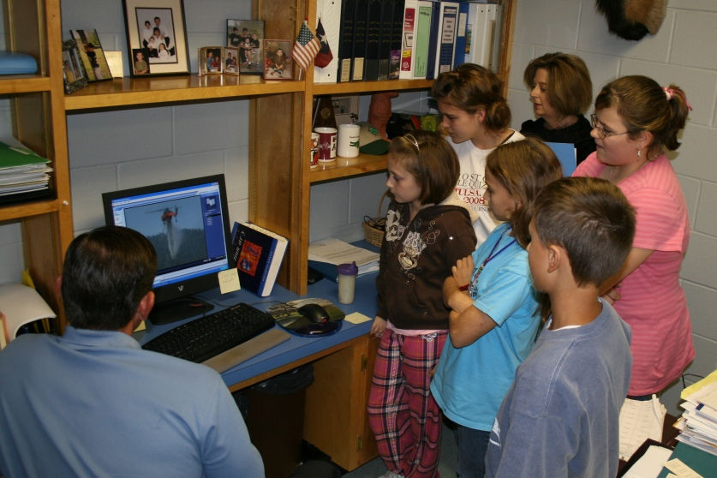
Candidates for the first Firewise school board watch the Firewise video.
Notes:
After watching a short video about Firewise, the first school board was formed.
They were hand picked, kids that may not always get to be in the limelight.

Slide 6
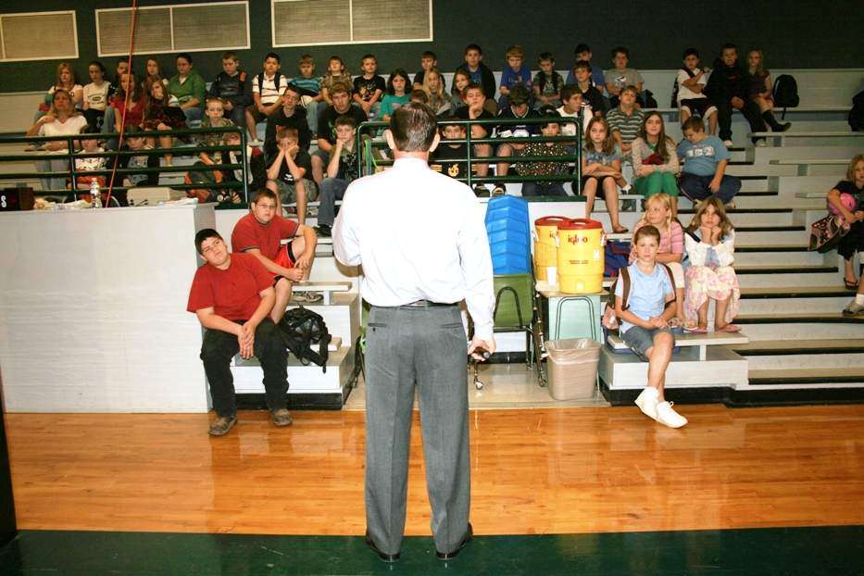
Principal, Mr. Trekel introduces the Firewise concept to students during morning assembly. 110 surveys given out.
Notes:
Son of a retired USDA firefighter.

Slide 7
Do YOU want to be a Junior Firewise Expert?
Rake leaves away from your house.
Move wood pile away from your home.
Move all flammable materials (like gas cans, paint cans, propane bottles) away from home and store them safely.
Sweep leaves and debris off wooden porches or decks.
Have someone help you trim tree limbs five feet off the ground.
Bonus question: What should you do if you see a fire?

Slide 8
Results of 34-home
Firewise Fuel Mitigation Project
Rake leaves 26
Move wood piles 26
Move flammable materials, store safely 27
Home address visible? 23 Yes
Gutters clear? 28 Yes
Road clear for fire equipment? 32 Yes
Chimney clear of trees? 13 Yes

Slide 9
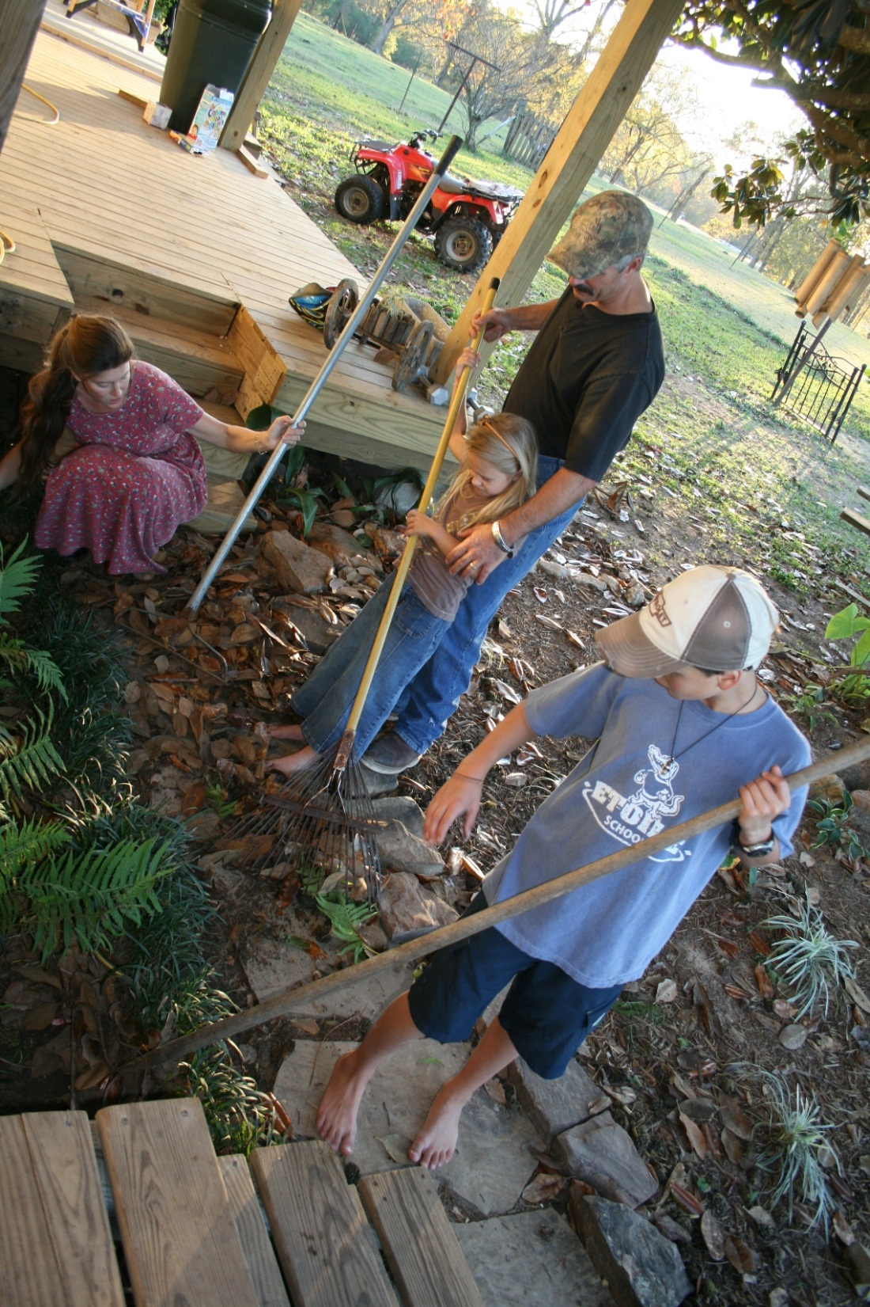
Win -- Kids
Win -- Families
Win -- Community

Slide 10
Go Gators!
The next project involved hard work: students, parents, teachers, the Texas Forest Service and Keep Nacogdoches Beautiful became involved in the first “Great Gator Rake”.
Notes:
Of the 110 surveys, 36 were returned and fuel mitigation had been done around 34 homes. We were off to a great start! We learned a lesson here, if you want the kids to return surveys, offer a prize!
Etoile Gators.
The Great Gator Rake!

Slide 11
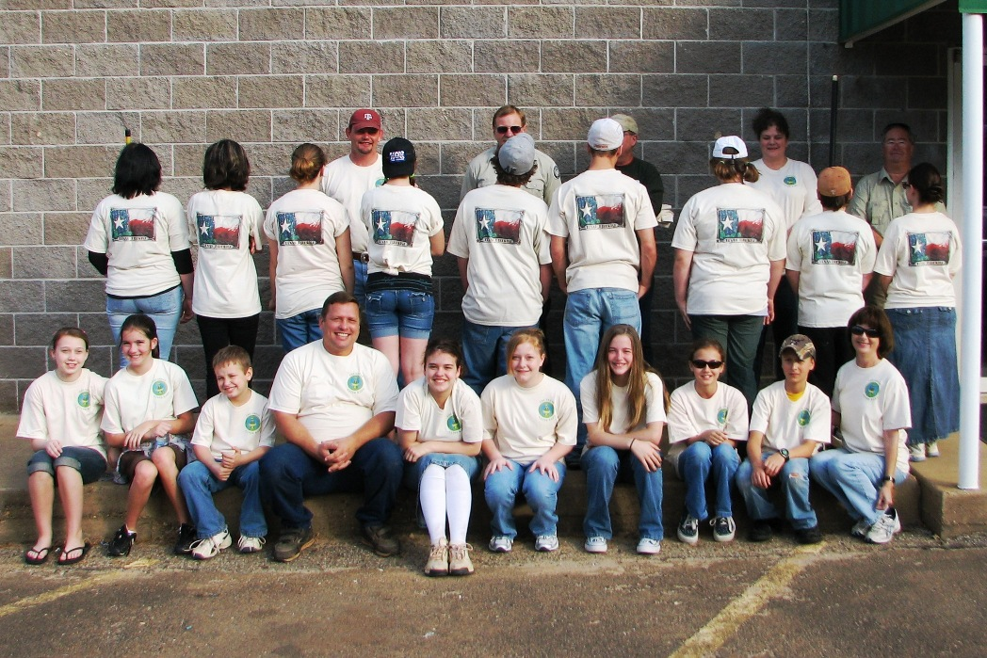
Participants were given t-shirts with the Great Gator Rake on the front and the Texas Firewise logo on the back!

Slide 12
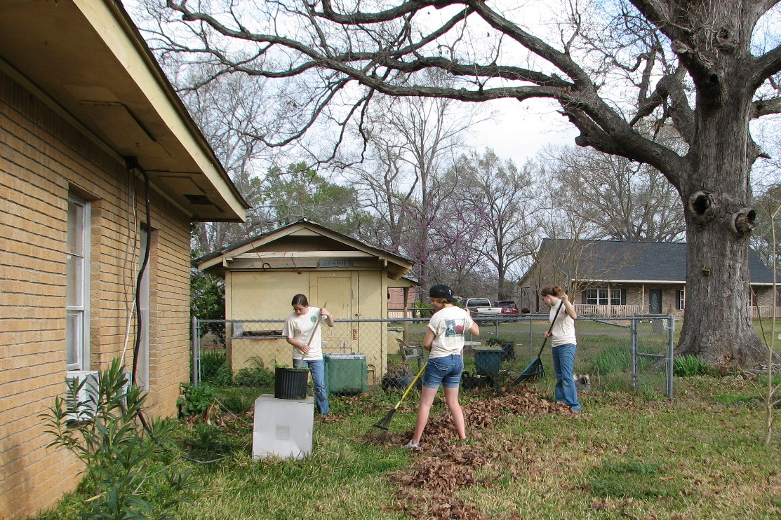
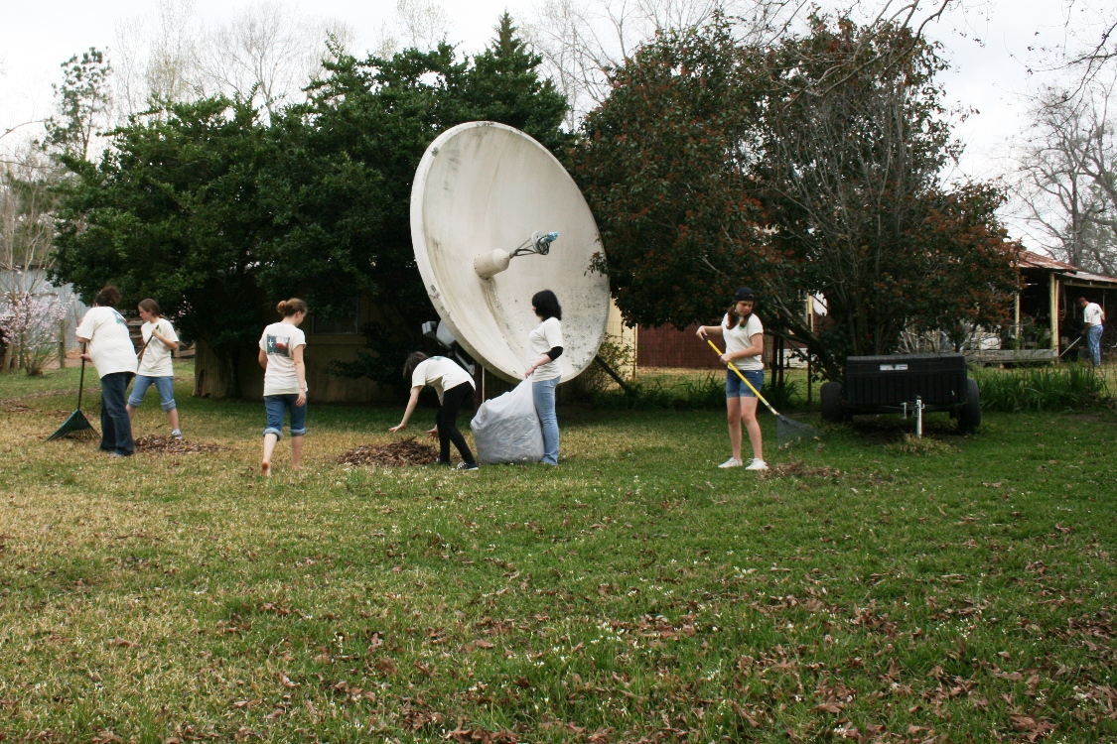
Everyone worked very hard that day, cleaning up around three homes, making them safer from the threat of wildfire.

Slide 13
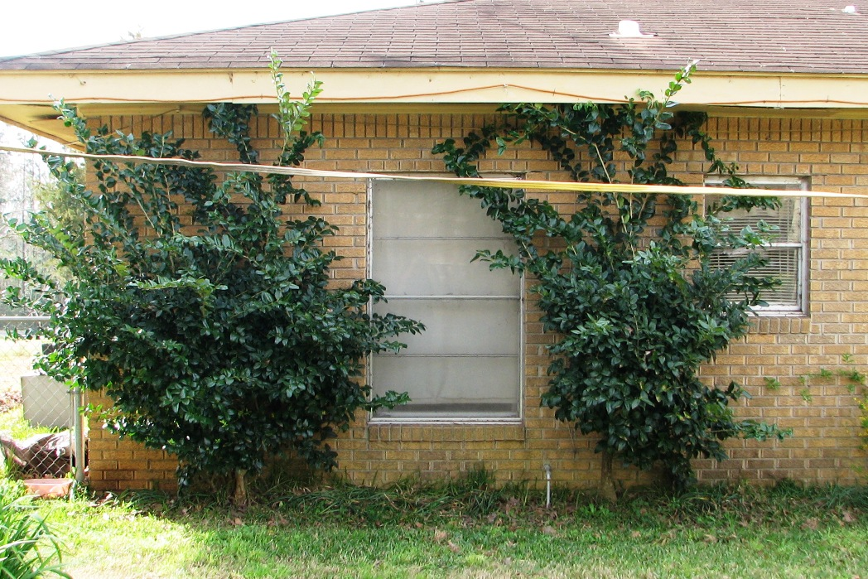
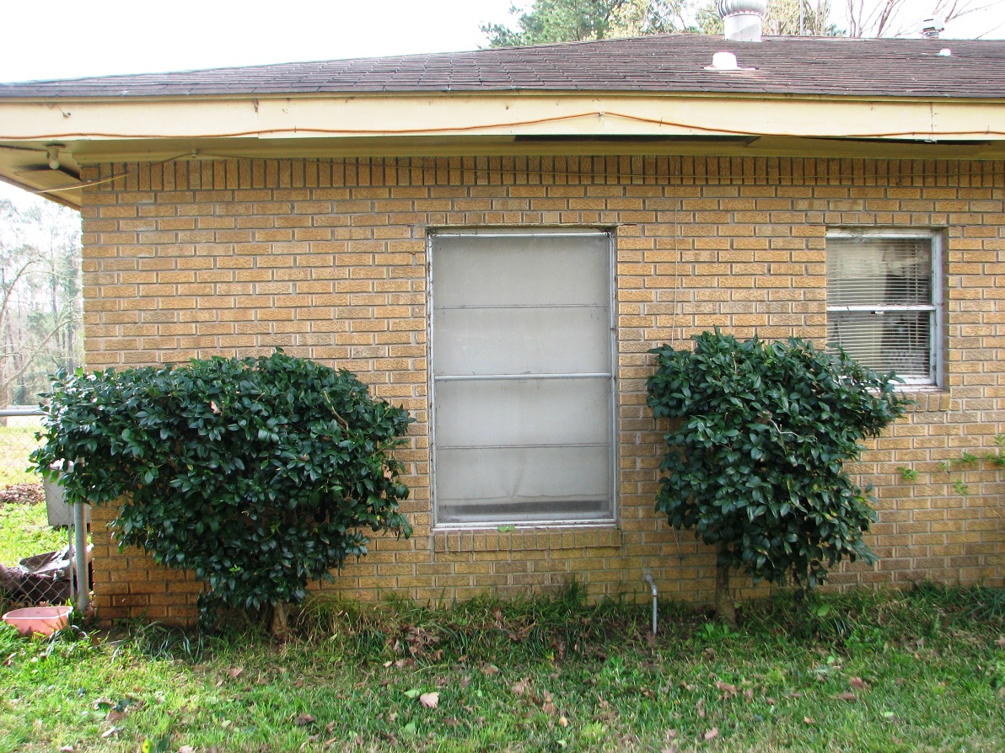
BEFORE
AFTER
Notes:
Here is an example of what can be done quite easily to keep fire from crawling up under your eaves.

Slide 14
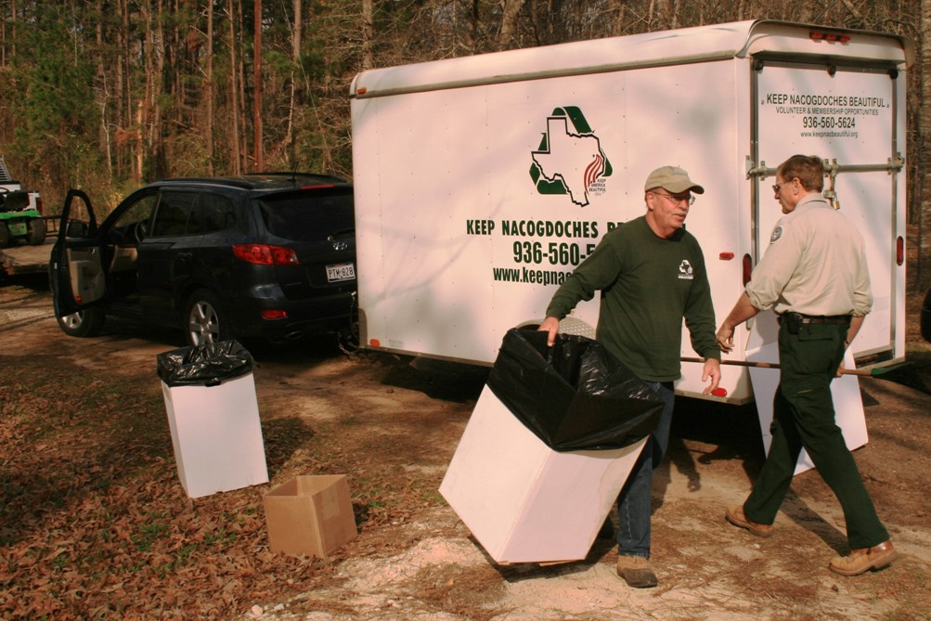
Notes:
Keep Nacogdoches Beautiful has been a great partner at every cleanup day.

Slide 15
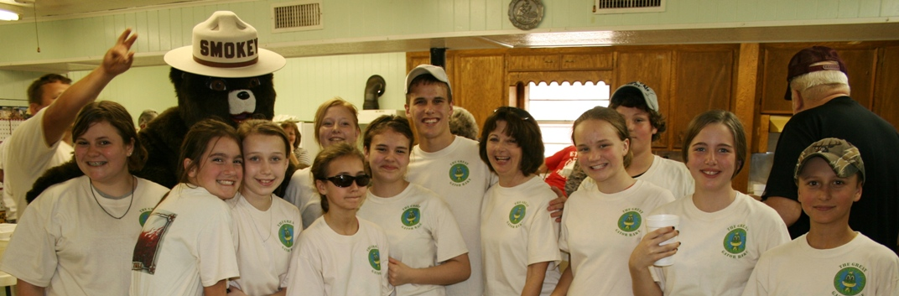
Notes:
Smokey Bear just happened to be at the fire station where Etoile VFD served us lunch. What a great day!

Slide 16
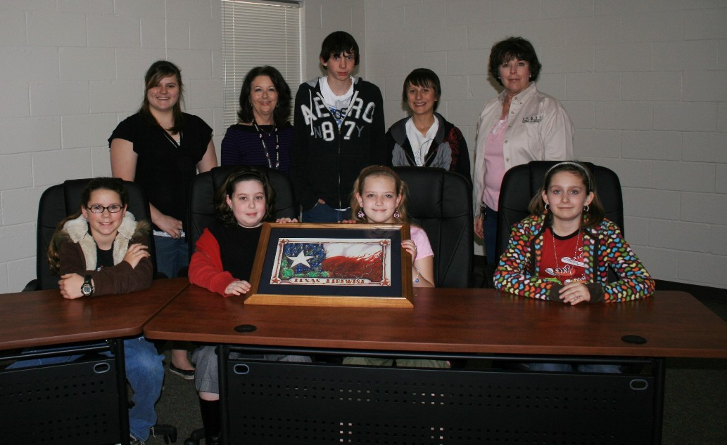
The second Firewise school board (2009-2010)
Notes:
As we entered our second school year, I had kids that were too young to participate asking when they would be able to be in the Firewise group!

Slide 17
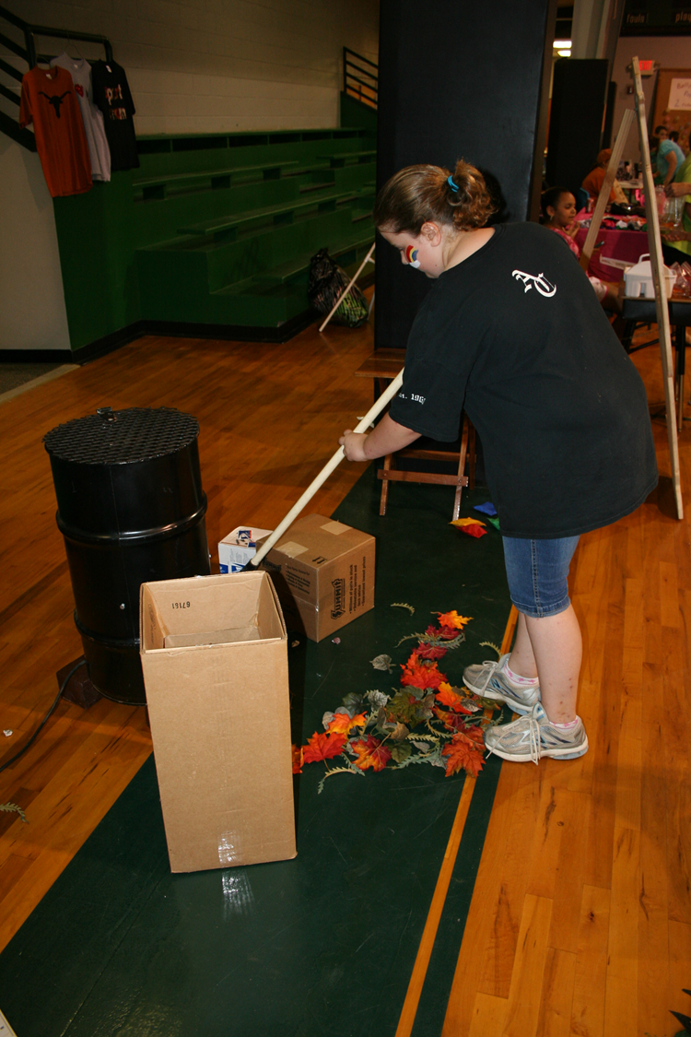
At a school “swamp fest”, we put up a display with Firewise materials. Here a student rakes leaves away from her burn barrel and talks about what other hazards are present.
Notes:
We took a display to several events this school year. This photo was taken at the Swamp Fest (keeping with the gator theme). We also took it to the Lufkin Zoo and the kids interacted with families, explaining what it means to be Wise about Fire. Kids educating grownups!

Slide 18
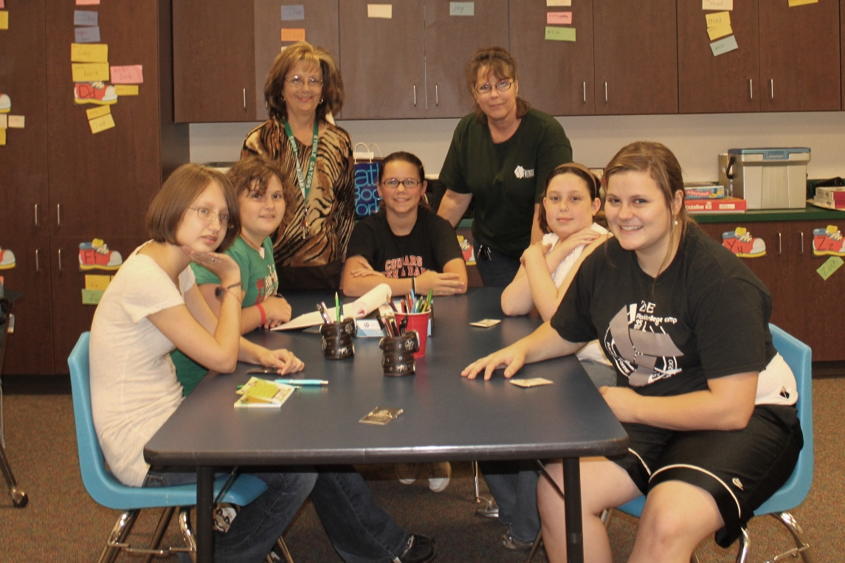
The Firewise school board (2010-2011)
Notes:
Amazing ideas come from these fresh minds. It encourages them to be forward thinkers, helps them with communication skills and allows them opportunities they may not otherwise have.

Slide 19
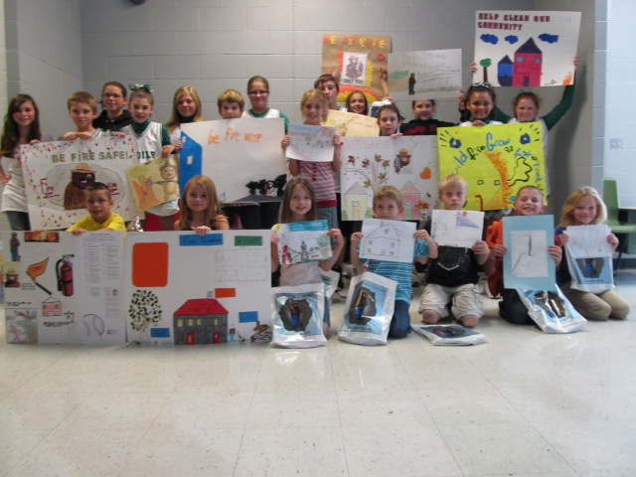
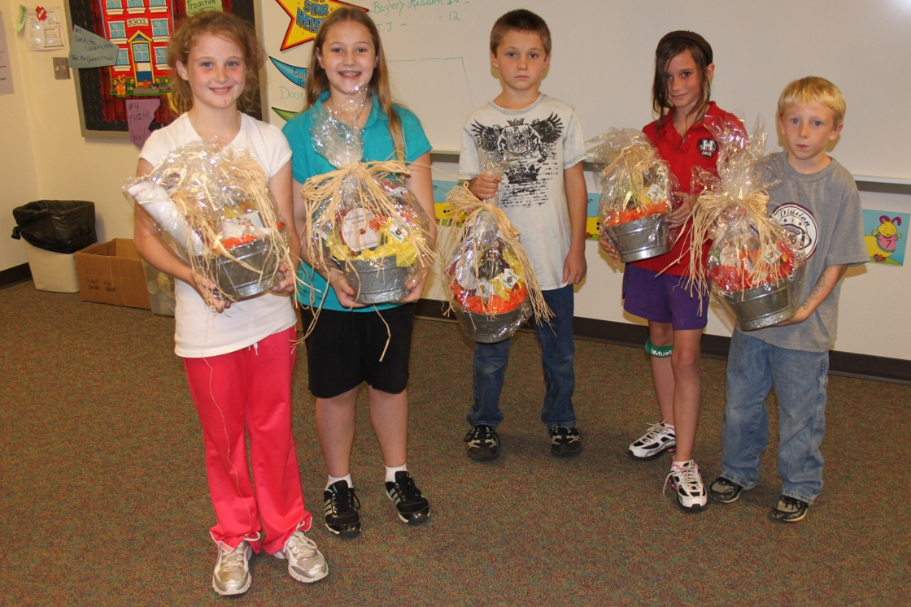
Poster contest entrants.
WINNERS!
Notes:
The poster contest was a lot of fun. The posters were all about fire, fire prevention and/or fire wise. My favorite was a drawing of the fire station with the caption “Etoile Volunteer Fire Apartment”…
Each person who drew a poster got a prize and there were five grand prizes awarded.

Slide 20
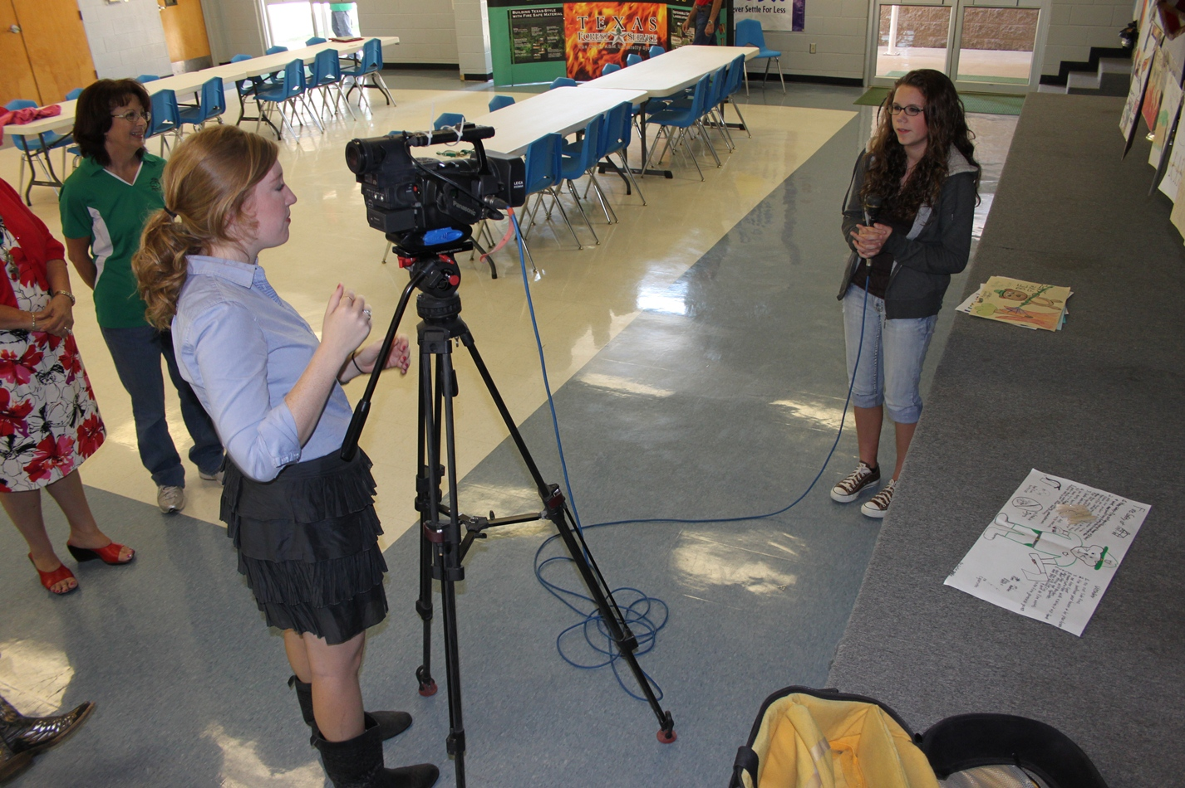
Local TV station interviewed students about Firewise and their poster contest.
Notes:
A local TV reporter came to the school for a story about Etoile being the first and only Firewise school in America. What a great experience for the kids to be on TV!

Slide 21
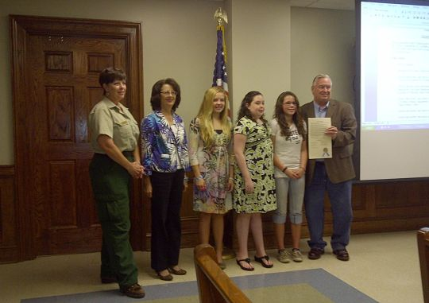
Nacogdoches County Commissioners Court, 2011 Court
Etoile’s Firewise school board was honored with a resolution endorsing Etoile ISD as a Firewise Community!
Notes:
One of the greatest honors that came from our hard work was when the Nacogdoches County Commissioners Court awarded us with a resolution endorsing Etoile ISD as a Firewise Community! Once again, the TV station was there for interviews… Meeting the judge/courthouse,

Slide 22
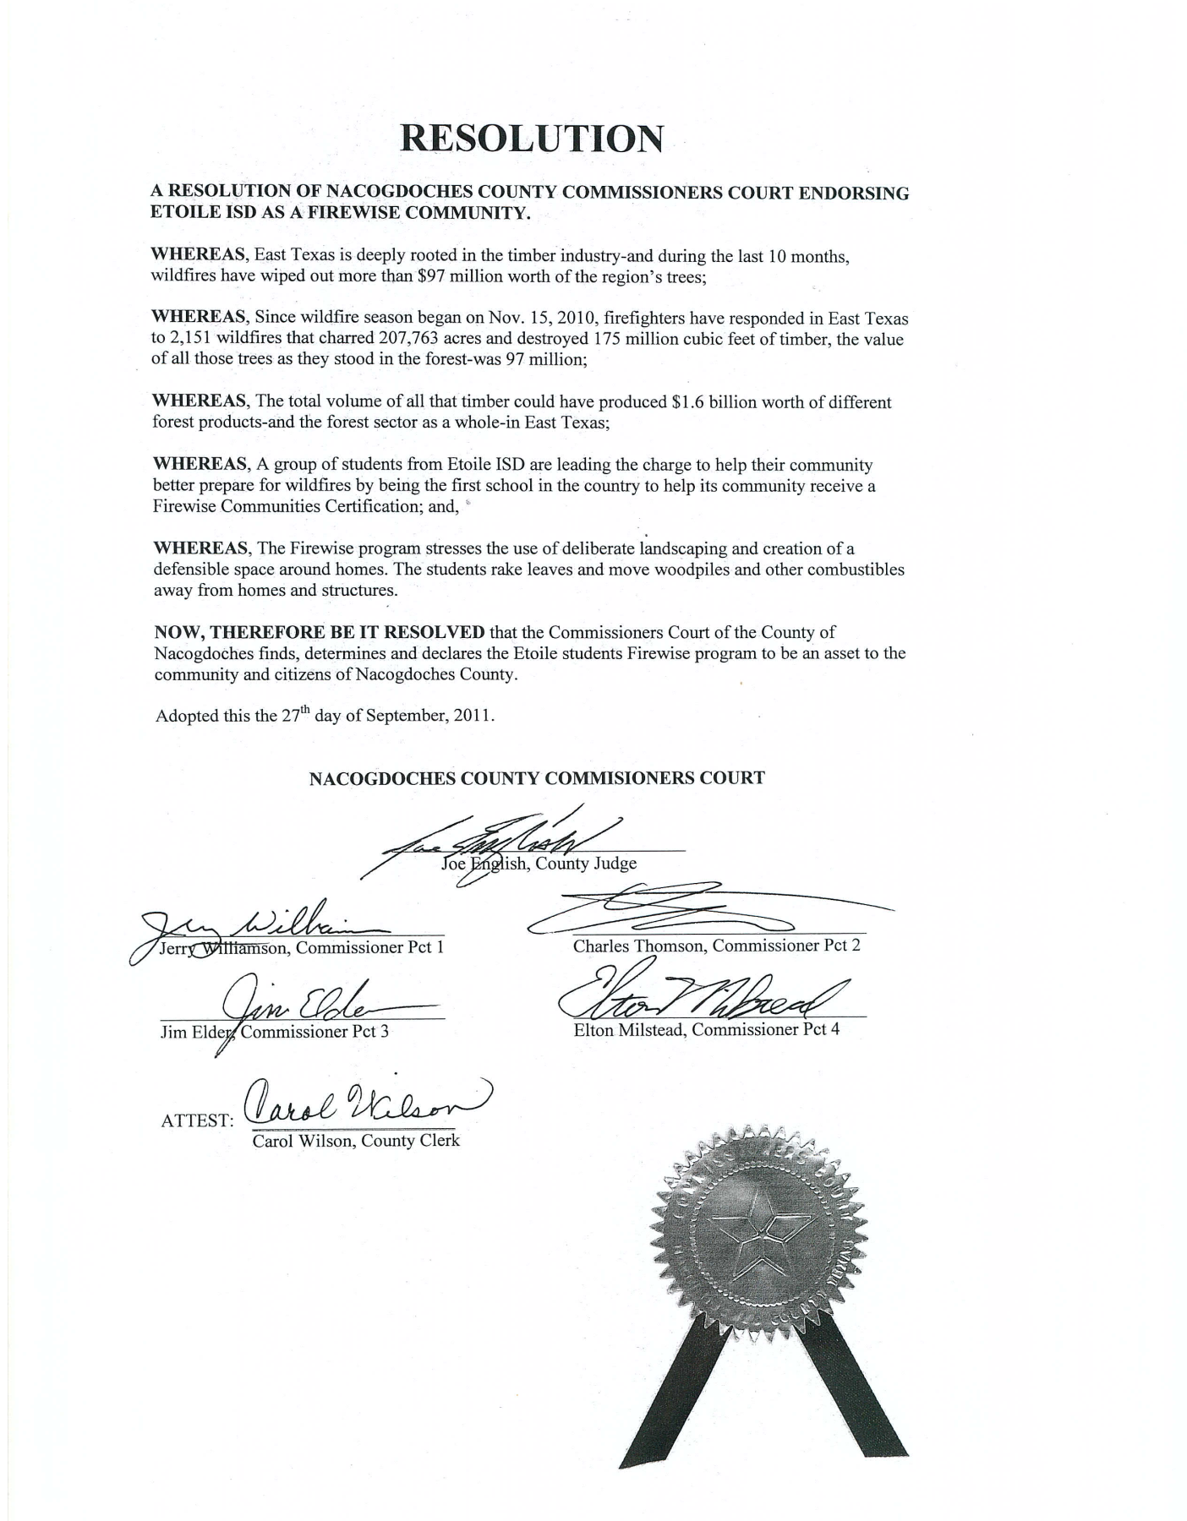
A RESOLUTION OF NACOGDOCHES COUNTY COMMISSIONERS COURT ENDORSING ETOILE ISD AS A FIREWISE COMMUNITY.
…declares the Etoile Students’ Firewise program to be an asset to the community and citizens of Nacogdoches County.

Slide 23
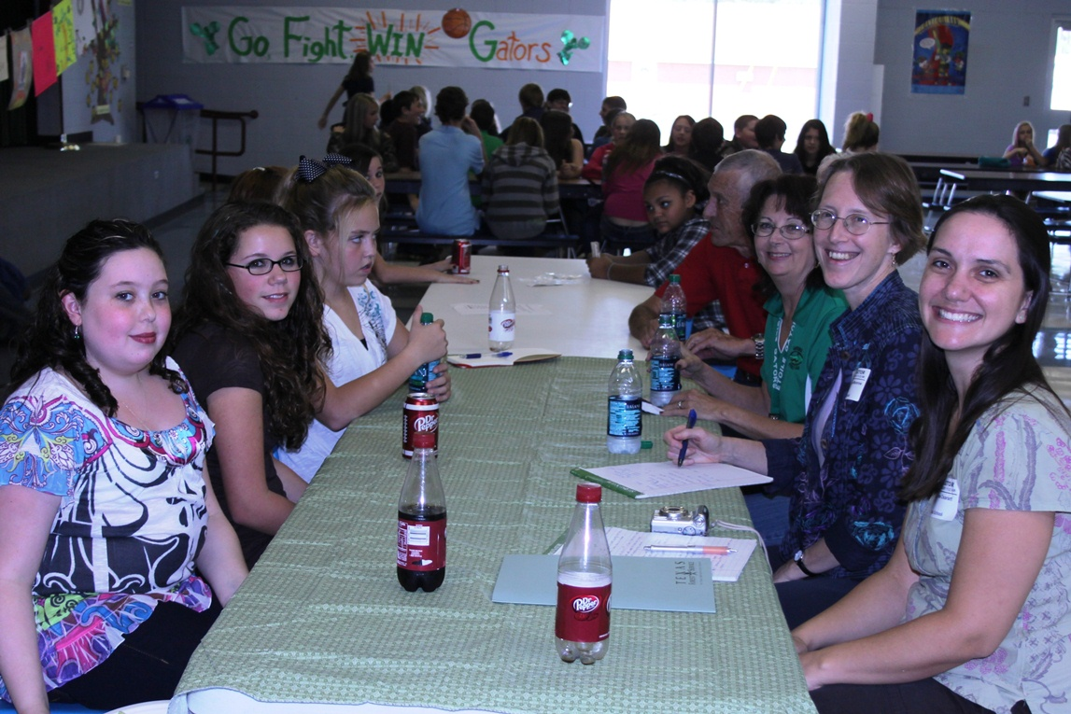
University of Florida researchers came to Etoile to interview the students about their Firewise involvement.
Notes:
The University of Florida learned about Etoile from the Firewise newsletter. They spent 3 days in Etoile interviewing students, staff, VFD members for a case study. (I have a copy of that with me)
“Not only do the youth bring enthusiasm and motivation, they approach the issue differently from adults. The students are more proactive than adults and have innovative ideas. Kids are more likely to go into other people’s yard to help out than are adults. Getting kids involved filters up and down and it spreads like wildfire.”

Slide 24
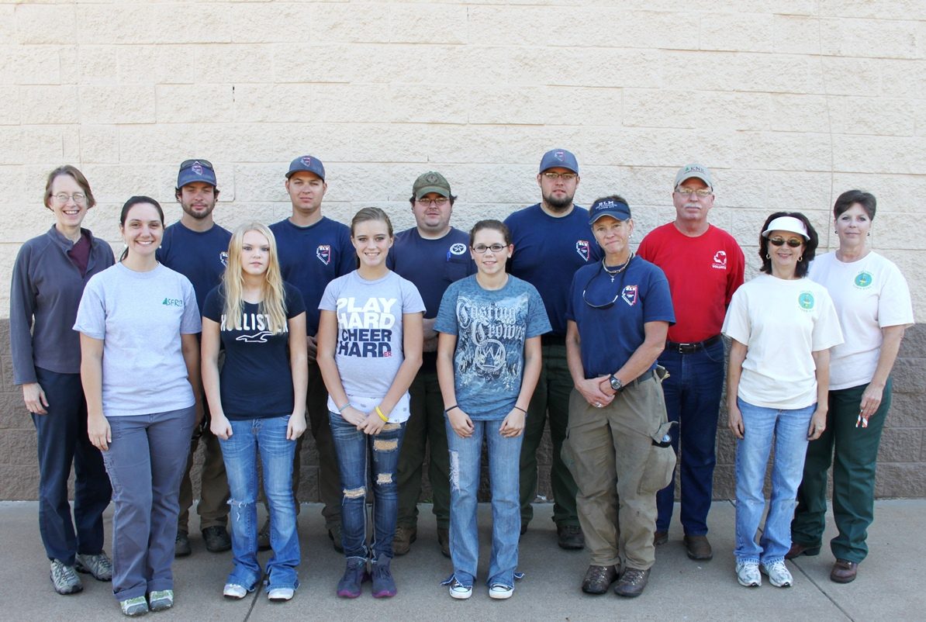
University of Florida researchers were able to participate in the 2nd Great Gator Rake, as were firefighters from the Texas Forest Service and an engine crew from Idaho who were in East Texas helping with the historic 2011 fire season.

Slide 25
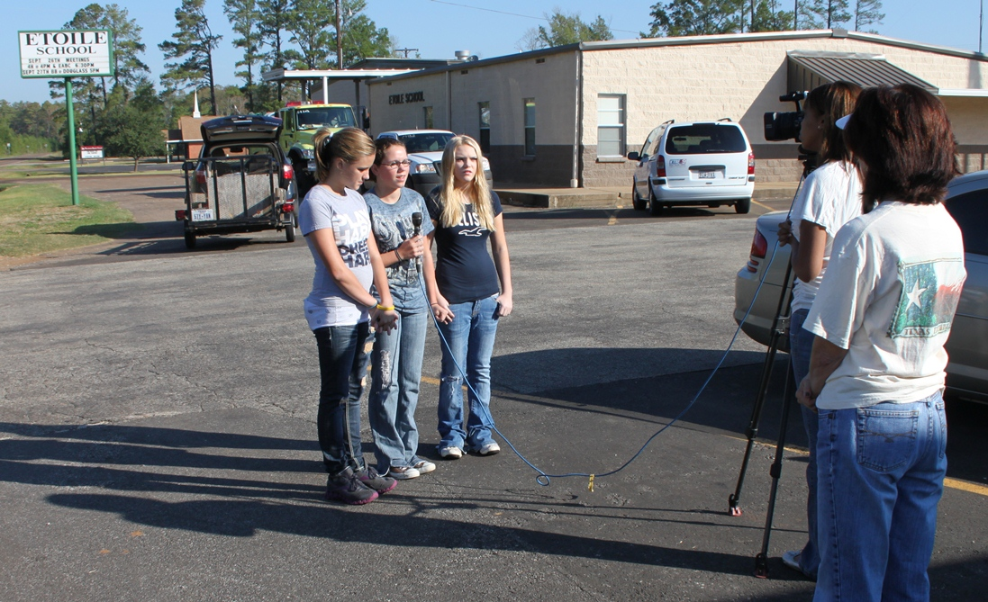
The kids got even more media attention for the second Great Gator Rake—both TV and newspapers were there.

Slide 26
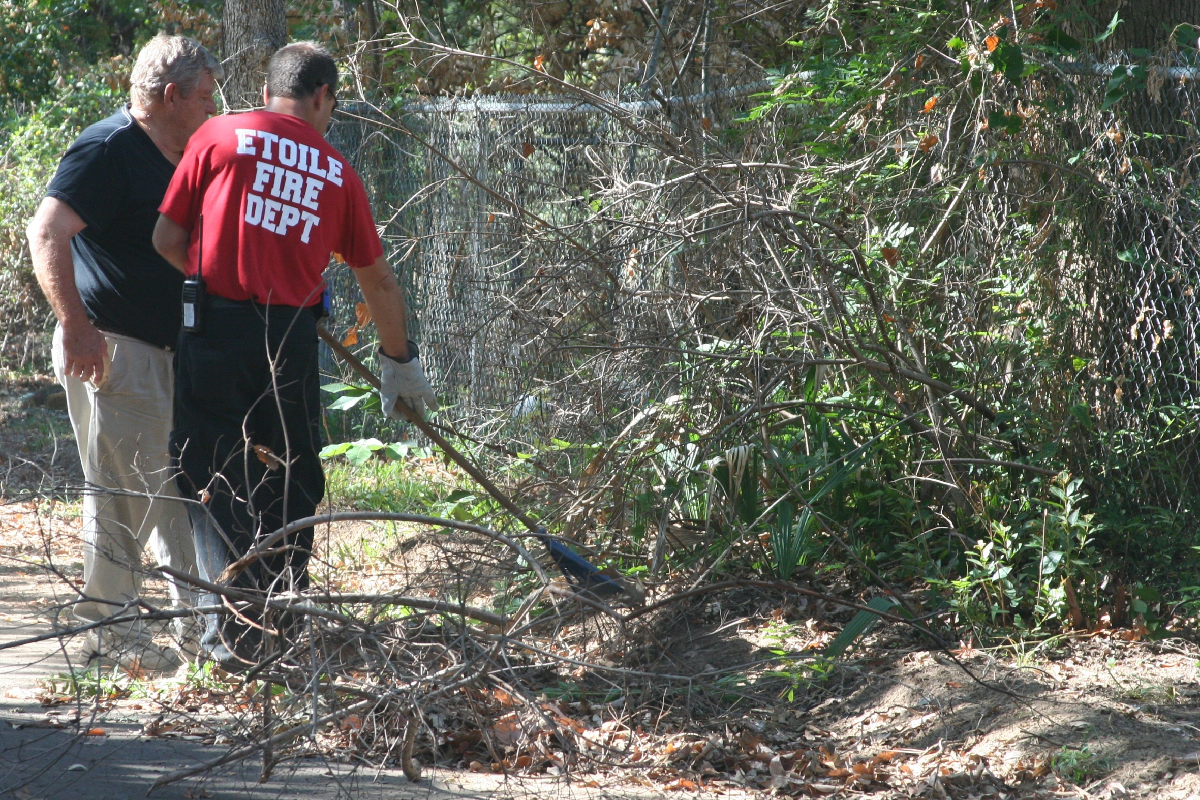
Notes:
Etoile VFD is a huge supporter of the Firewise project.

Slide 27
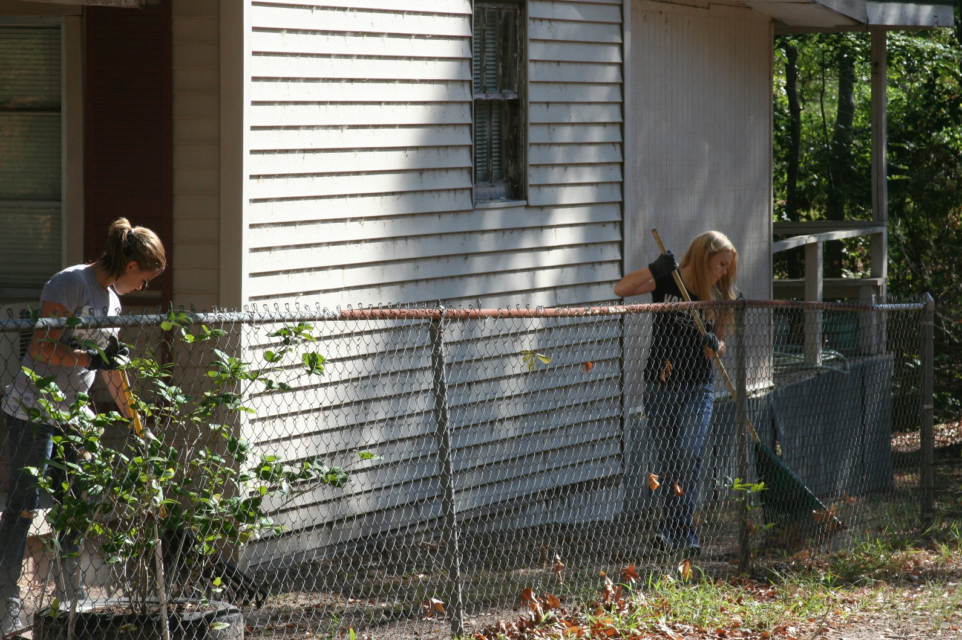
Notes:
We did a “target” house, getting permission ahead of time then went down the street asking people if they would let us onto their property with rakes.

Slide 28
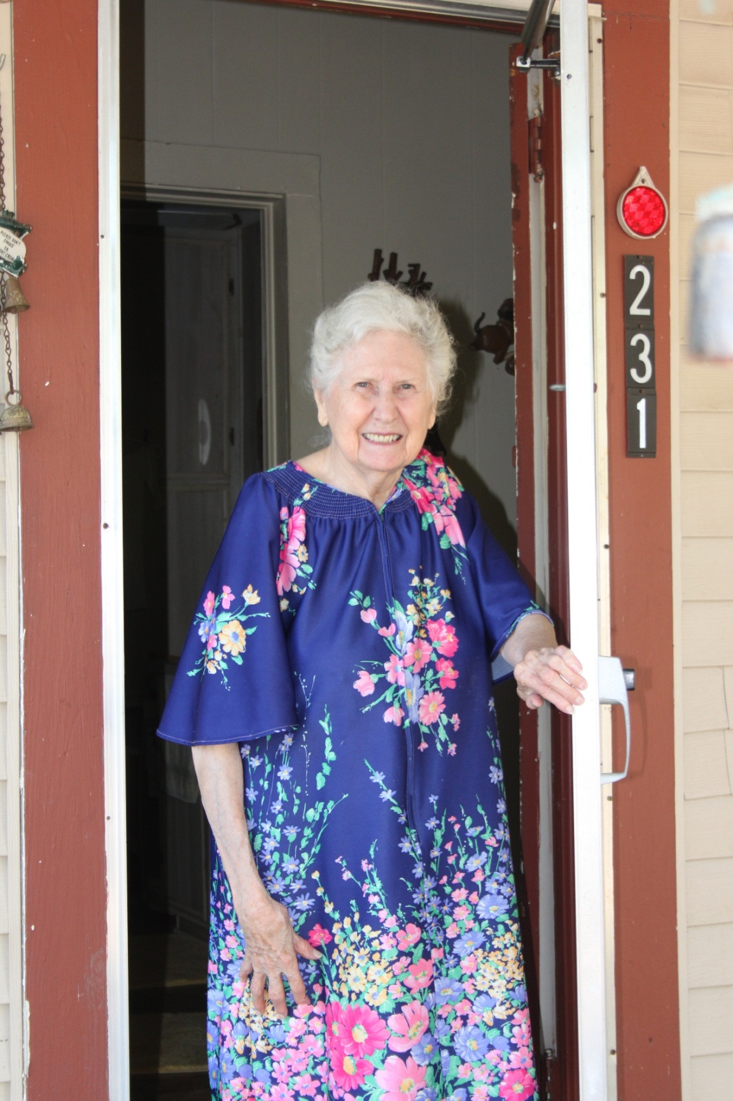
The success of the kids’ hard work shows in this homeowner’s face. She was thrilled that we were doing some of the “mitigation” work in her yard she could not easily do herself.
Notes:
Her house was really in pretty good shape but the yard was full of leaves and pine straw. It looked so nice when it was raked up—you can tell by her hands how much pain we saved her--she was so happy.

Slide 29
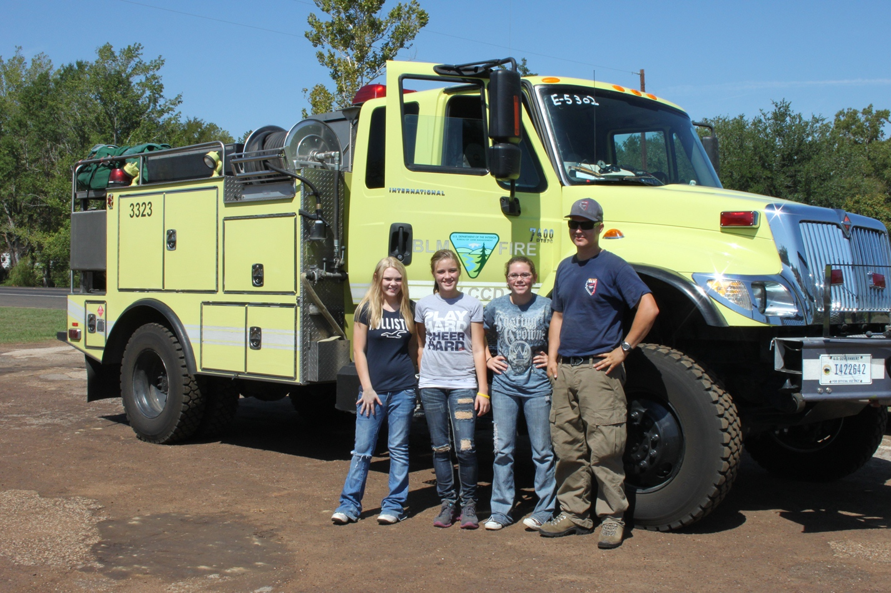
The girls enjoyed a ride around the block in the Idaho engine.

Slide 30
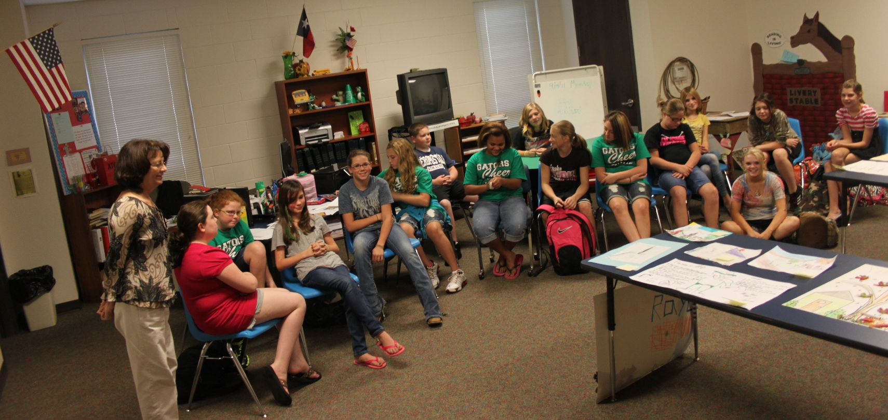
The Firewise school board (2011-2012)
Notes:
This photo attests to the popularity of Firewise! They hold an election and run the meeting with modified Rules of Order.

Slide 31
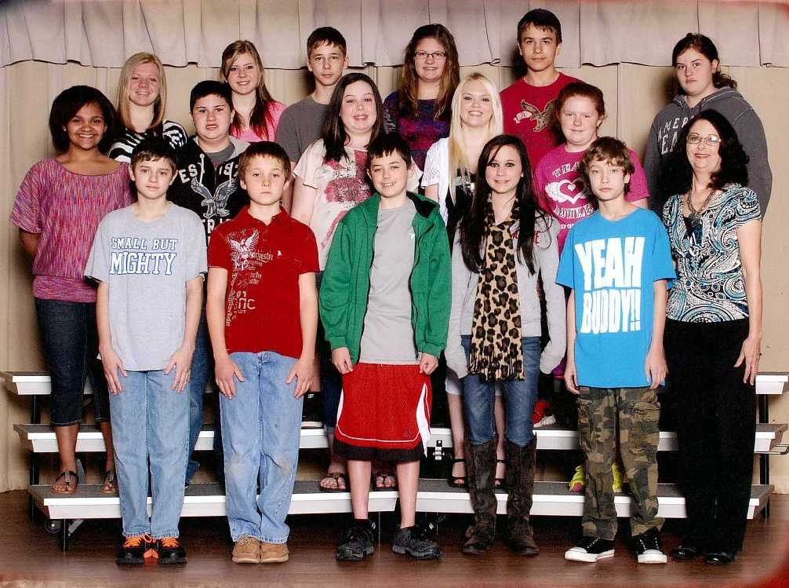
The Firewise school board (2012-2013)
Notes:
I was very pleased to receive my own copy of this photo, taken when school pictures were taken. It means a lot to me. Some of these kids have been in Firewise for years, following in their siblings’ footsteps!
Ms. Tootle is on the first row, far right. She is passionate about Firewise and we’re blessed to have her as advisor all these years. Current Principal, Sarah Hottman is fabulous and a huge advocate for Firewise.

Slide 32
This past school year, the board decided to write a script about being Firewise and perform a puppet show. They posted the performance at Schooltube.com
Roll that beautiful bean footage.
Notes:
VIDEO (~3 minutes)
They came up with this script all by themselves as a team.
The puppets were donated to TFS by a fire department and then ended up in the fire prevention cache.

Slide 33
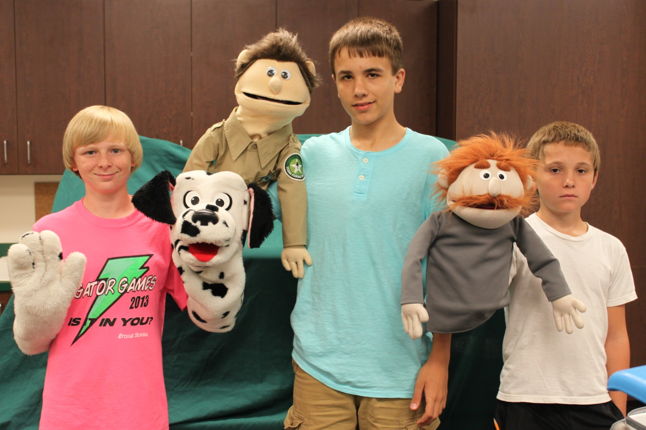
Puppeteers: Logan, Tanner, Willie
Notes:
I didn’t change their script except to take Smokey Bear out of the mix.

Slide 34
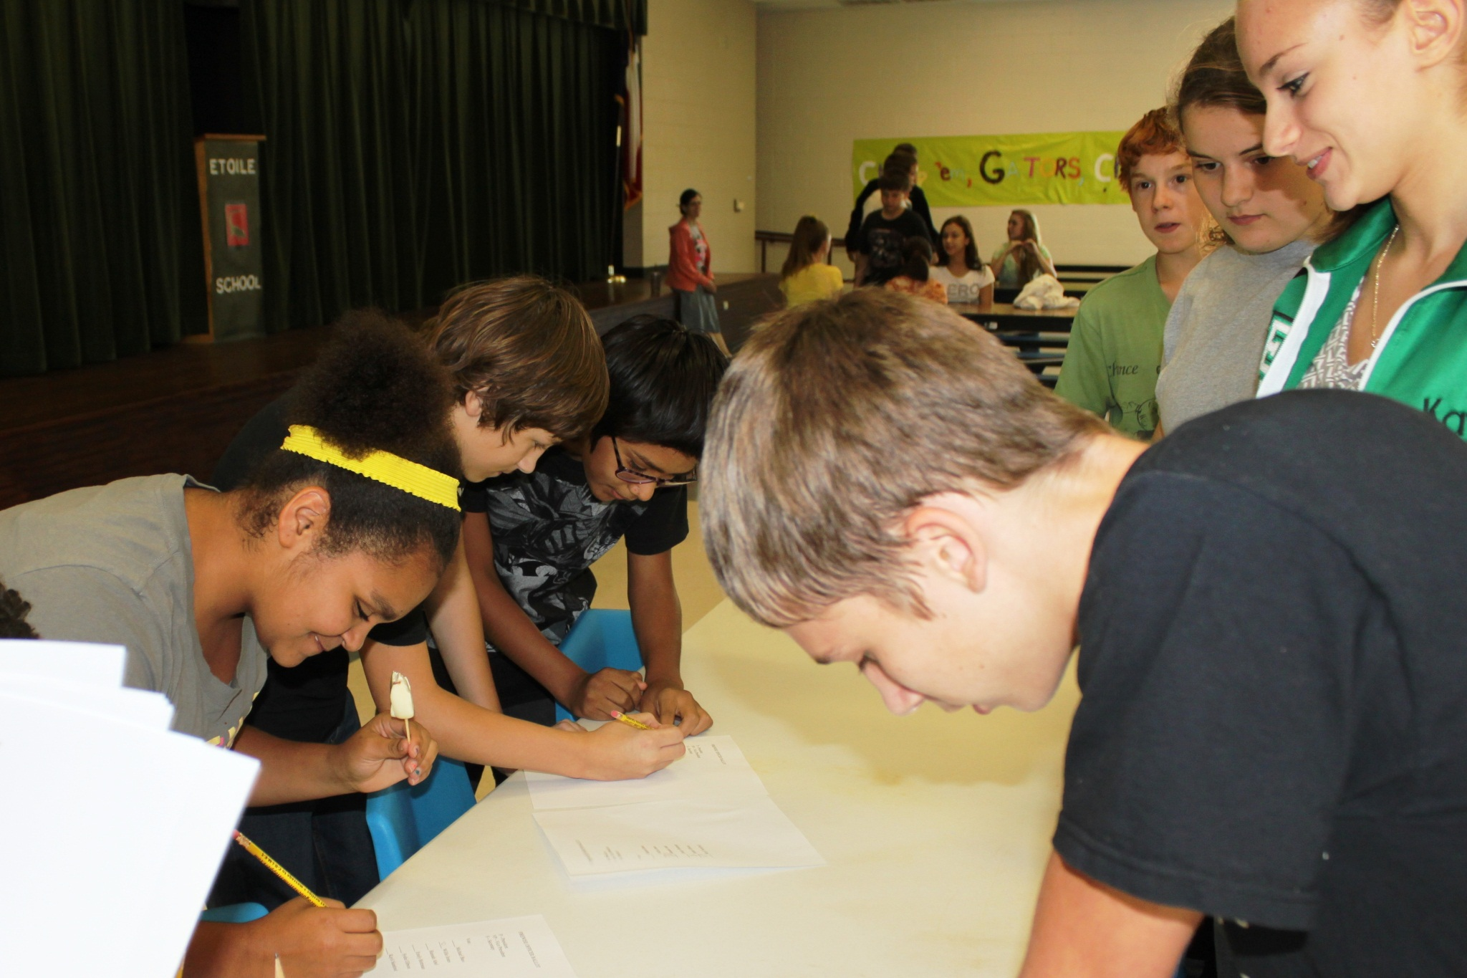
2013 Voting Day

Slide 35
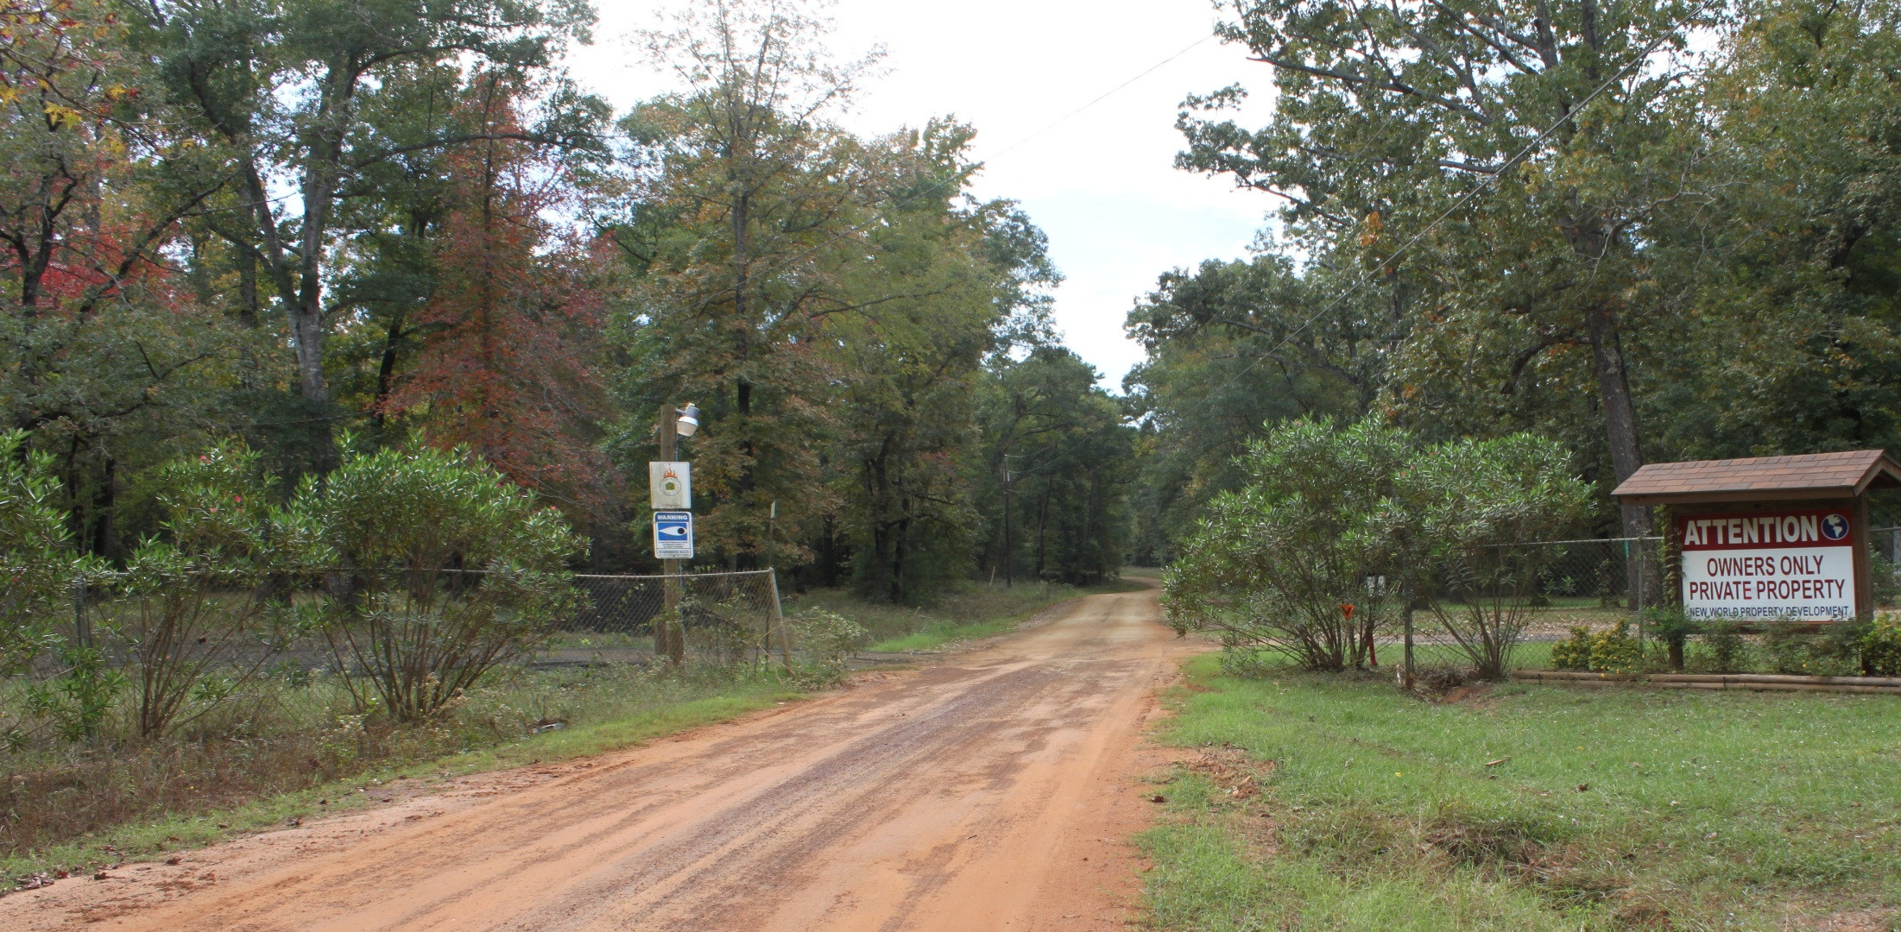
This is the entrance to “New World”, a very remote subdivision
about eight miles from Etoile School.
They are also a Firewise Community.
Notes:
This “gator rake 3” is planned for December 6.

Slide 36
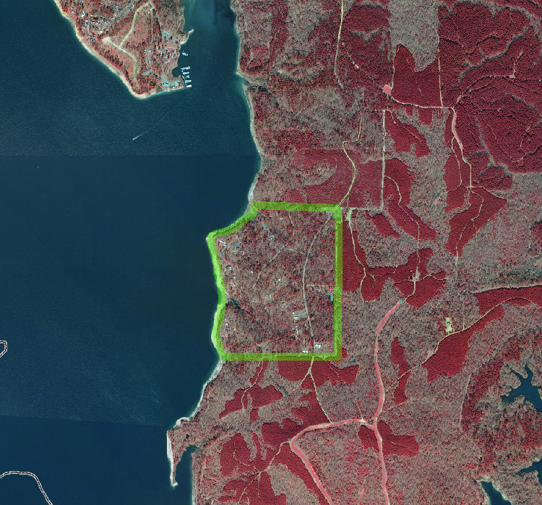
MAPS here
Lake Sam Rayburn
New World

Slide 37
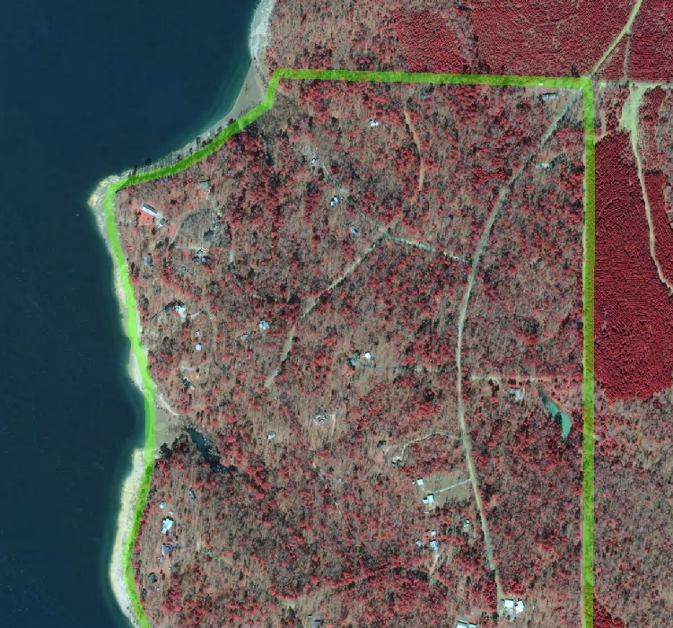
Lake Sam Rayburn
New World

Slide 38
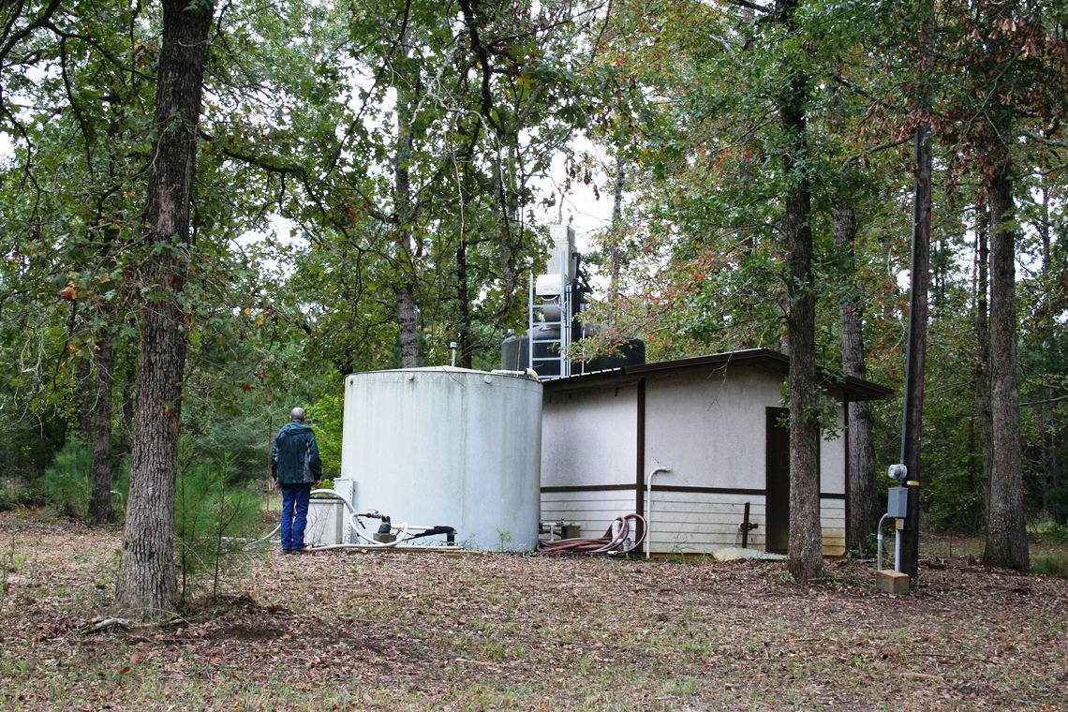
Notes:
This lot is at the entrance to a remote subdivision in Etoile, also a Firewise Community. It could be that this is the first time in America that two Firewise communities work together on a project. I hope so anyway!
New World is in a unique location—surrounded on three sides by dense pine plantation and on the fourth side by Lake Sam Rayburn. Their Emergency Escape Plan includes water rescue!

Slide 39
Plans are in the works to put together another video on Schooltube.com where the Etoile students tell, in their own words, how they became a Firewise school in hopes that other schools will do the same.

Slide 40
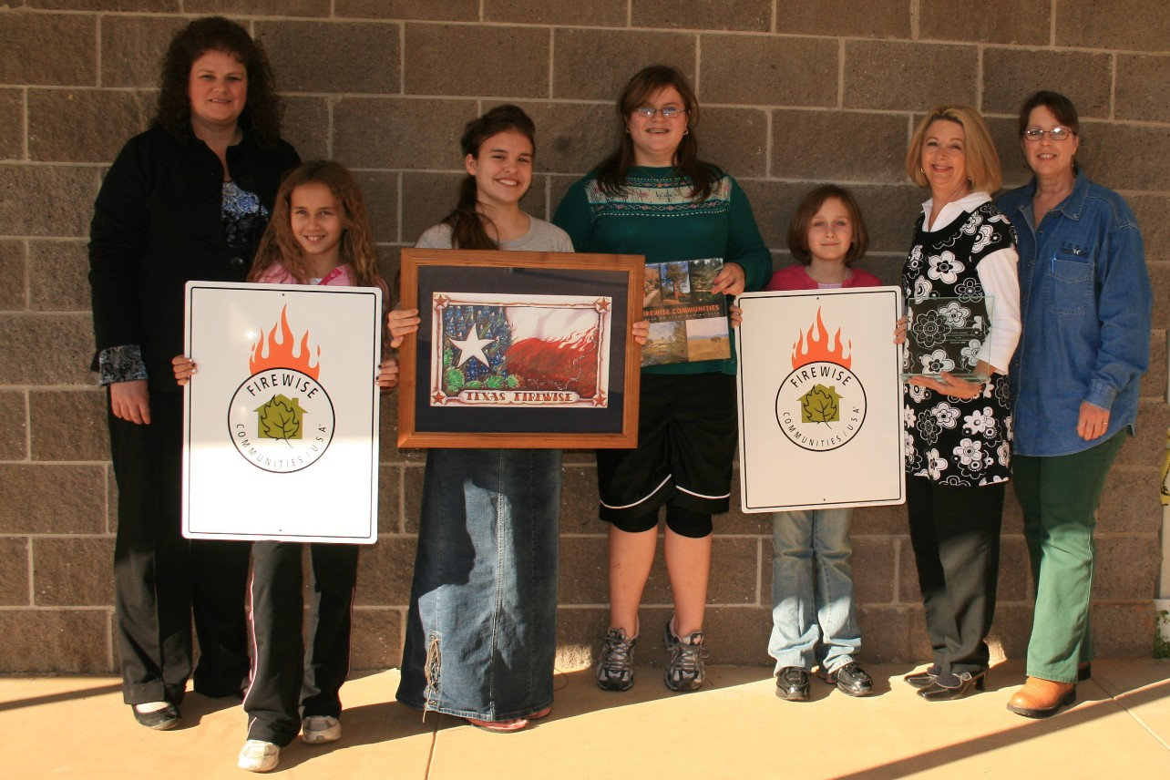
The first Firewise school board (2008-2009)
Notes:
These kids and this program have received recognition nationally via the National Firewise Communities program, through Schooltube, through the University of Florida case study and now here in Salt Lake. They received local notoriety through media interviews and by the official Resolution presented by the Nacogdoches County Commissioners Court. It has been a wonderful experience for everyone involved. One student in an interview put it this way: “you don’t have to be big to make a big difference.”

Slide 41

Firewise.org
Etoile.esc7.net
Schooltube.com
Jan Amen
jamen@tfs.tamu.edu
936/546-1004
Notes:
You’ve been the best 3rd grade class I’ve ever had.
Copy of Case study for your perusal.

