Slide 1

Flagstaff Watershed Protection Project
Fires, Floods, Fences and Funding
November 14, 2013
MARK BREHL
City of Flagstaff
Fire Department

Slide 2
Flagstaff Watershed Protection Project
Fires, Floods, Fences and Funding
Not one size fits all
Substitutions ARE required
This is our story,
how we got here from there

Slide 3
Flagstaff Watershed Protection Project
Fires, Floods, Fences and Funding
FROM
All Trees Are Good and All Fires Are Bad
TO
Cutting 2M trees (in the City - 2013), and Lighting more fires than we put out
FROM
Forests and fires are the feds problem
TO
Voter Approval of tax monies for forest treatments outside of City on fed lands

Slide 4
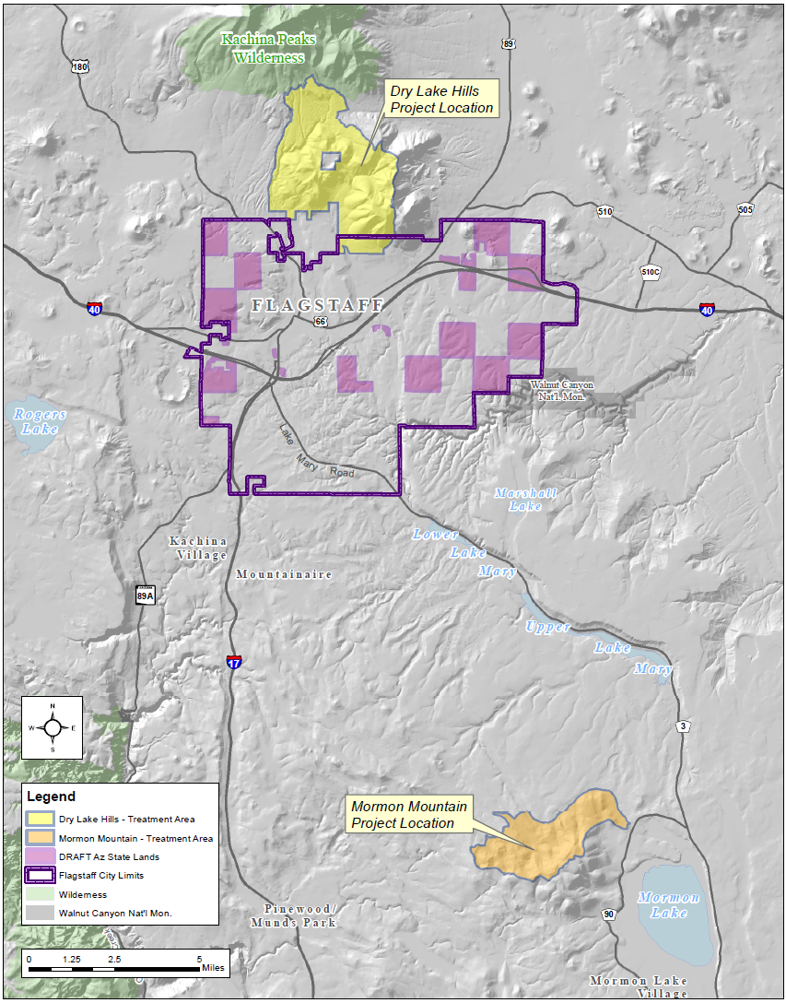
Flagstaff Bond Question #405
Amount: $10,000,000
Where:
Rio de Flag – USFS and State
Lake Mary – USFS
Description: To prevent flood damage to the City and to protect the City water supply from damages which occur from large-scale and/or severe wildfire(s) in two watersheds serving the City
Partners: USFS, State
NAU, GFFP, County

Slide 5
Flagstaff Bond Question #405
Timing
  Fire and flood threat is certain and annual
  State and Federal Funding is uncertain
  Forest treatments in parts of these two watersheds not planned to occur at all, or scheduled 10+ years into the future
Fire and water impact is ours
  Little direct fire threat to Flagstaff in these two areas
  Post Fire flood impacts – Center of the bulls eye

Slide 6
Flagstaff Bond Question #405
Short-term financial impact is substantial
  Large Fire financial impact to City: $70M (est)
Long-term cost of recovery > Proactive mitigation
  Schultz Fire: $12M Suppression +
  $150M recovery (& growing)
  Lake Mary $22M (est) for new wells or
  $22M (est) for dredging/treatment
  Rio De Flag $750M- $1Billion (est) recovery
  (est from Schultz Fire Costs)

Slide 7
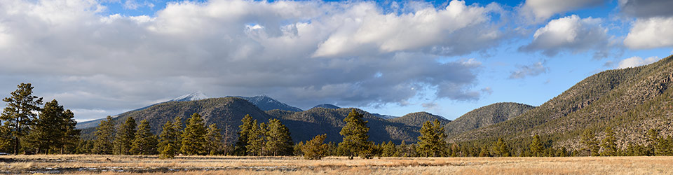
Flagstaff Bond Question #405
Purpose: Flood prevention
If approved, bond would: Expedite and conduct forest treatments and environmental analysis in the watershed primarily north of town to reduce wildfire threat, thereby mitigating subsequent flooding to Sunnyside, downtown, the NAU campus, and neighborhoods bordering the Rio de Flag
U.S. Forest Service lands
north of, and outside, of
the City
City’s backdrop
and flood-shed

Slide 8
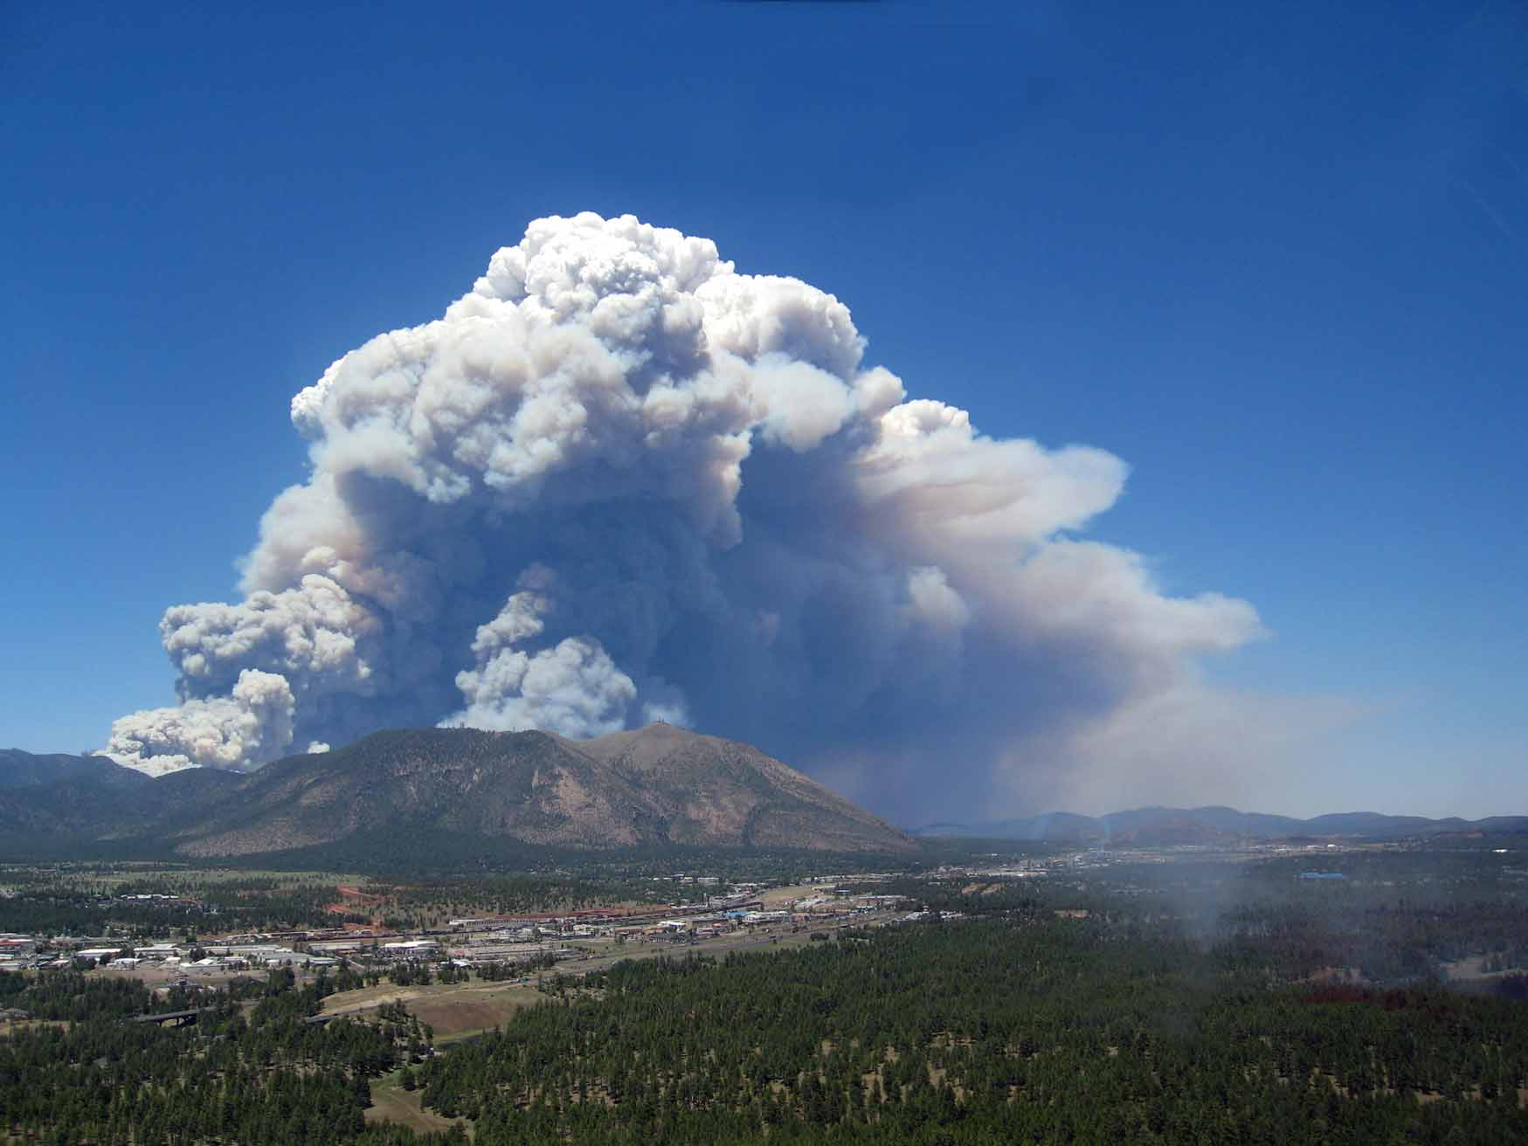
Flagstaff Bond Question #405
2010 Schultz and Hardy Fires

Slide 9
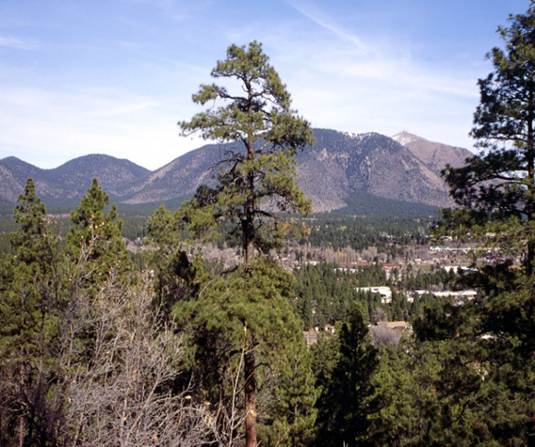
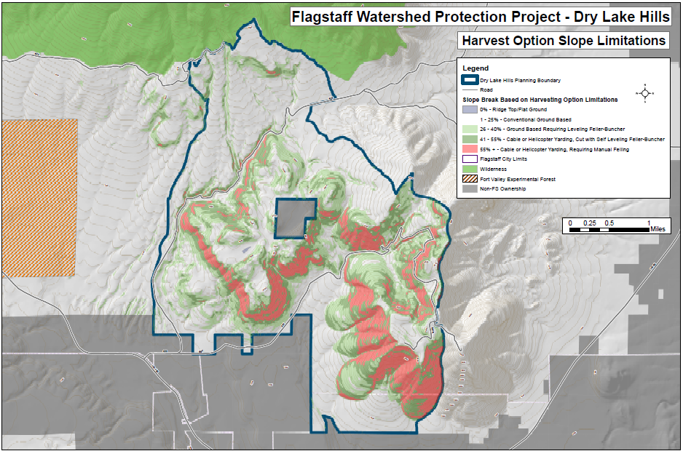
Flagstaff Bond Question #405

Slide 10
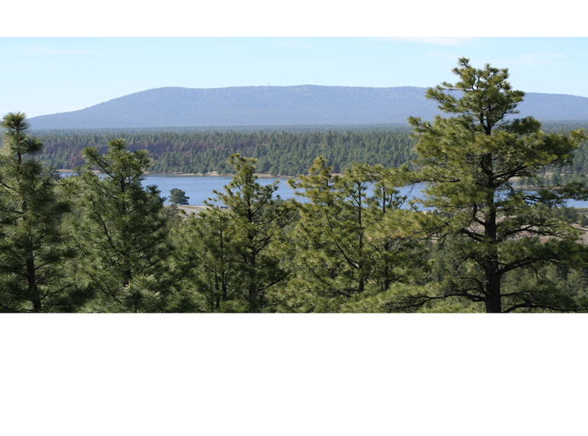
Flagstaff Bond Question #405
Purpose: Protect storage capacity and water quality
If approved, bond would: Plan and conduct forest treatments and environmental analysis in the watershed south of town to reduce wildfire threat, thereby protecting the storage capacity and water quality of Lake Mary
U.S. Forest Service lands
south of, and outside, of
the City
50% of City’s water supply Key recreational value

Slide 11
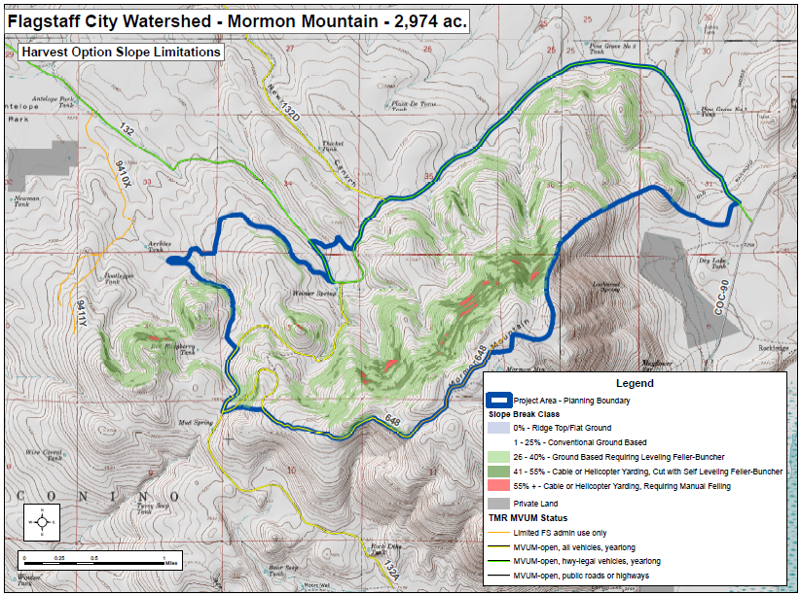
Flagstaff Bond Question #405

Slide 12
Flagstaff Bond Question #405
  Accelerate planning and treatment activities within 4FRI area near Flagstaff
  Leverage other State and Federal funds
  Expand scope and size of planned forest treatments:
Rio de Flag – 4FRI funding – 2,360 acres
City bond – 6,780 acres
----------------
9,140 acres
  Lake Mary – 4FRI funding - 32,000 acres
  City bond - 4,000 acres
  ------------------
  36,000 acres

Slide 13
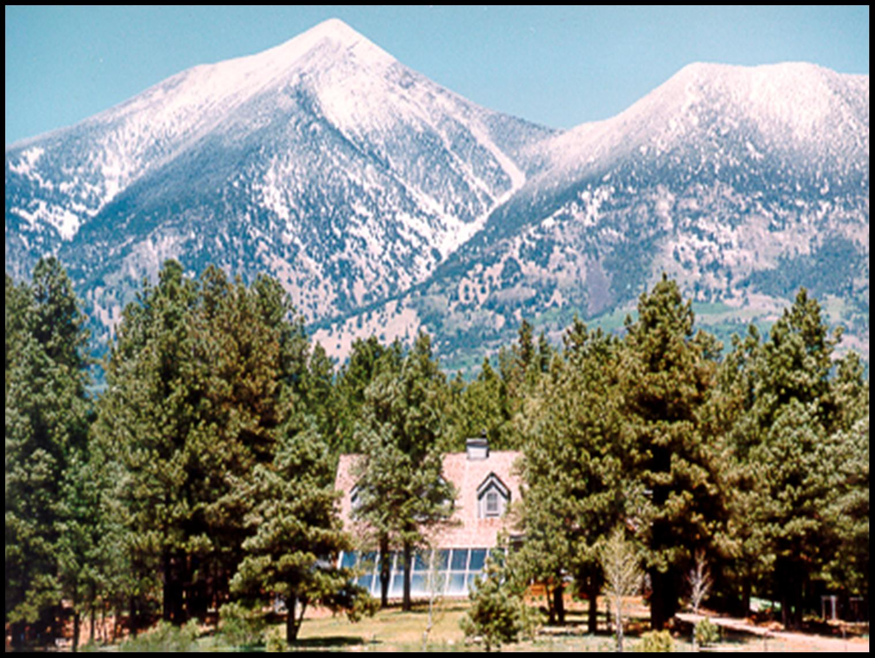
Why Flagstaff?
Relationship to the Forest

Slide 14
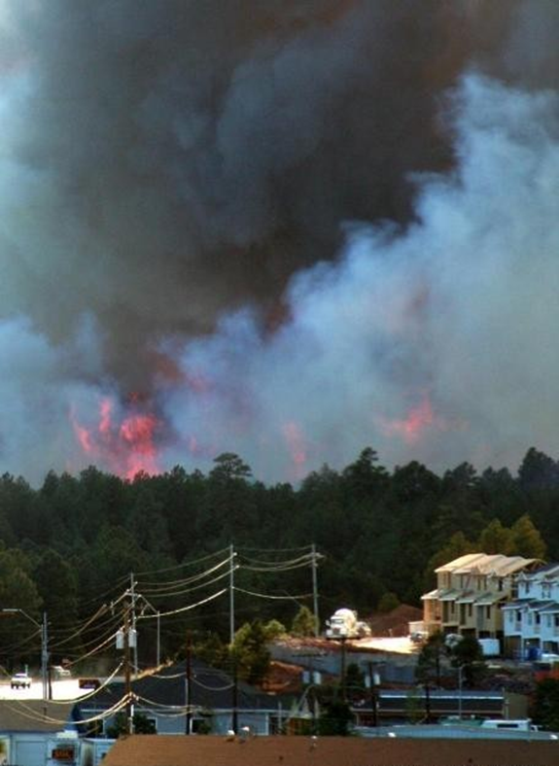
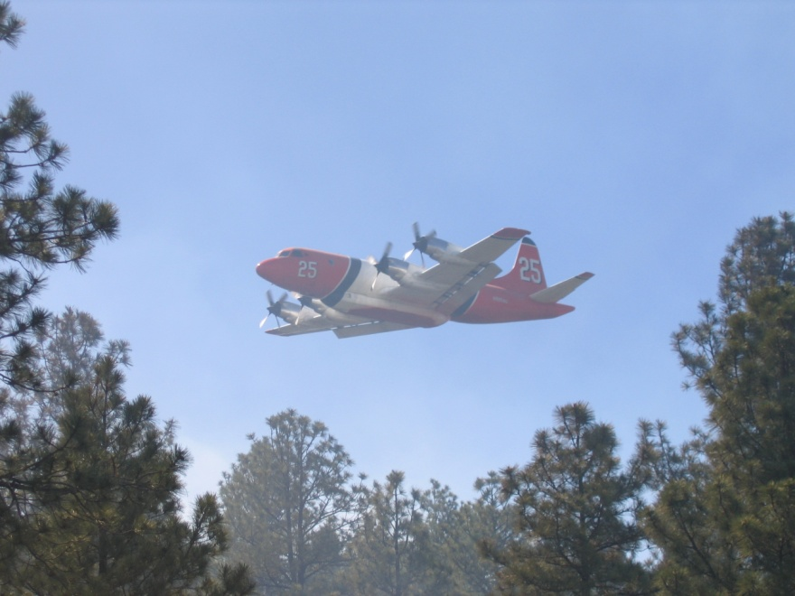
Why Flagstaff?
Relationship to the Forest,
Strong awareness of the Threat

Slide 15
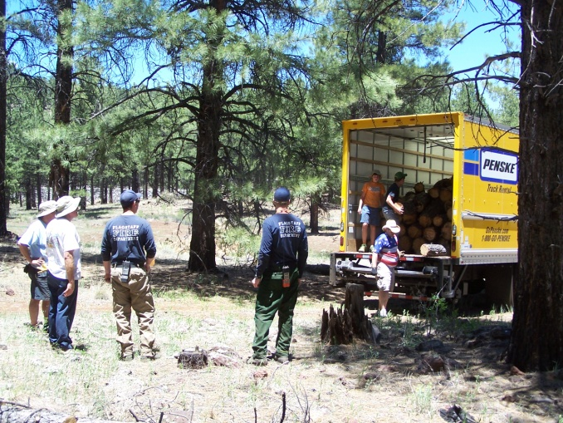
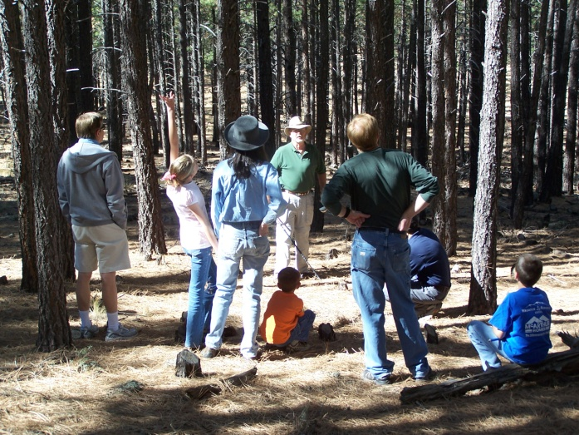
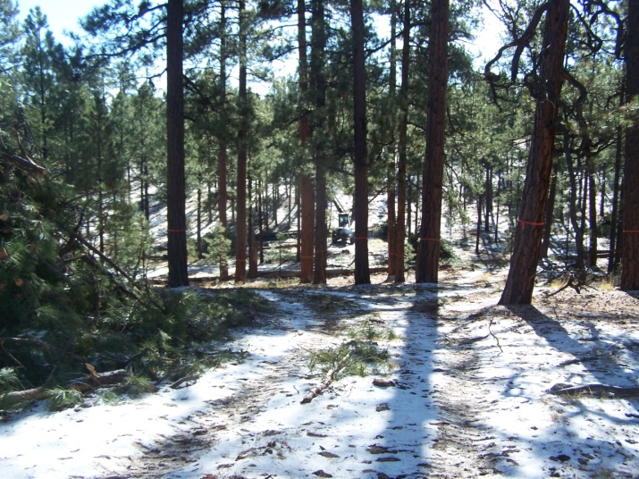
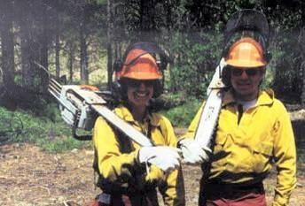
Why Flagstaff?
Relationship to the Forest,
Strong awareness of Threat
History of City Leadership & Action

Slide 16
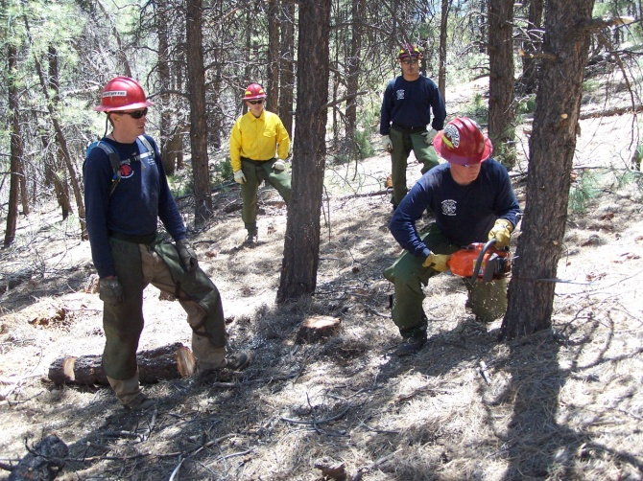
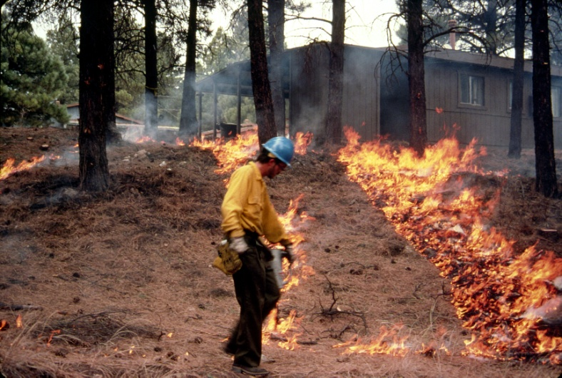
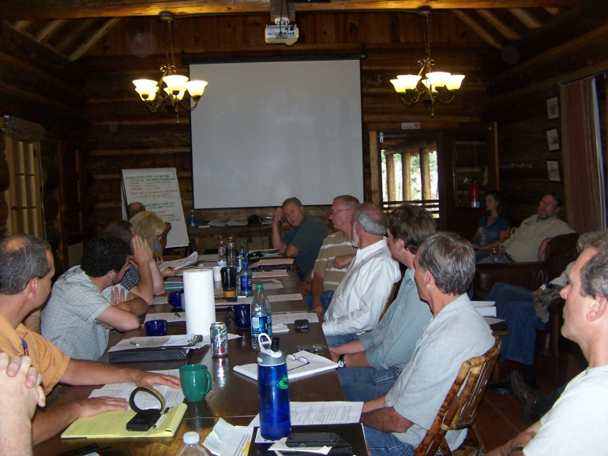

Why Flagstaff?
Relationship with Forest,
Strong awareness of Threat
History of City Leadership & Action
Long-standing Partnerships

Slide 17
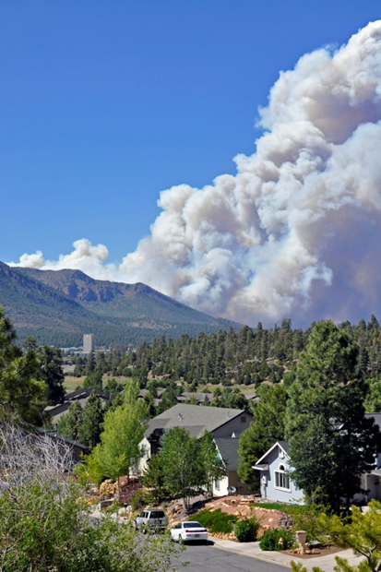
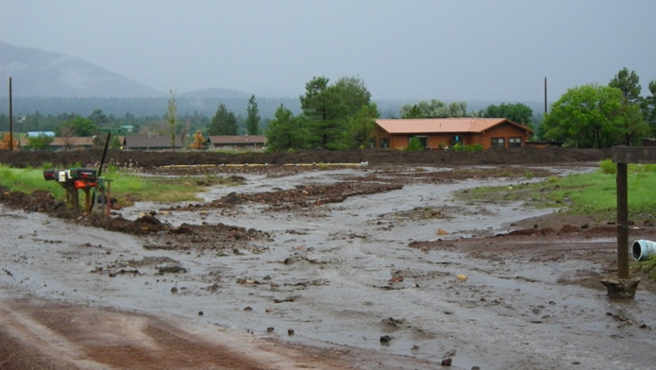
Why Flagstaff?
Relationship with Forest,
Strong awareness of Threat
History of City Leadership & Action
Long standing Partnerships
Timing

Slide 18
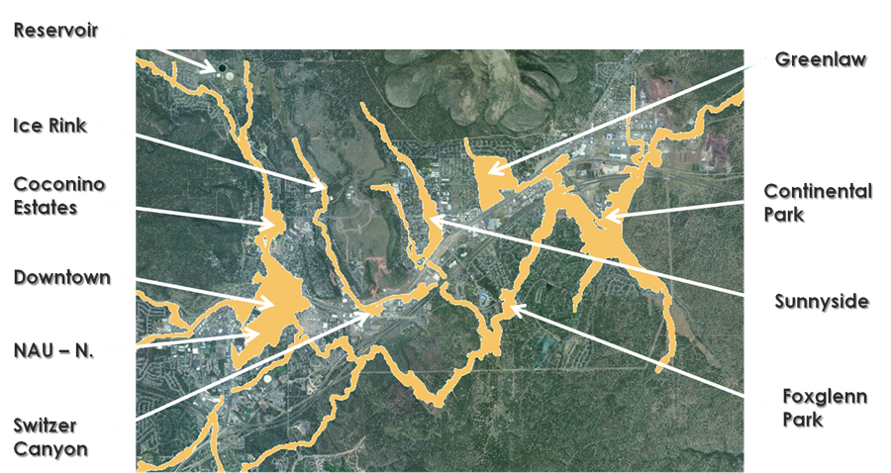
Why Flagstaff?
Linkage → Flood Impacts

Slide 19
Why Flagstaff?
Linkage → Water Supply
We typically think of a “water system” in terms of infrastructure: reservoirs, stream channels, treatment plants, pipelines, meters, and taps.
But our water comes from the Forest, so is not our Forest part of our “system” as well, perhaps the most important part?

Slide 20
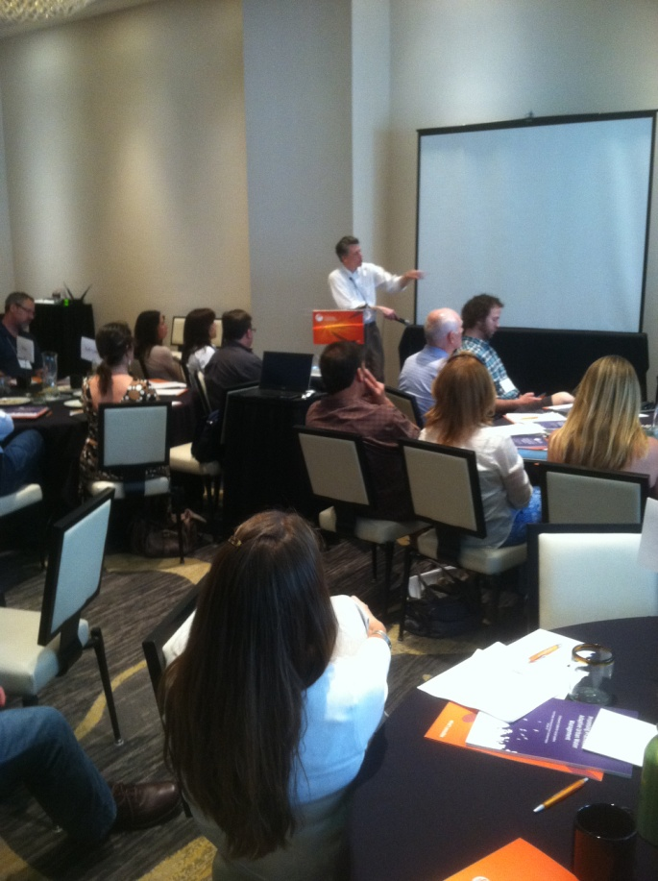
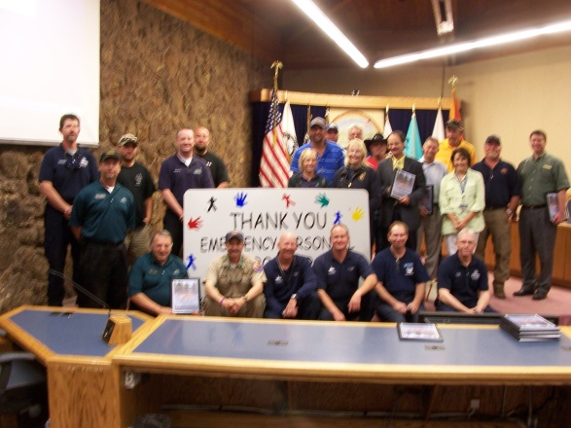
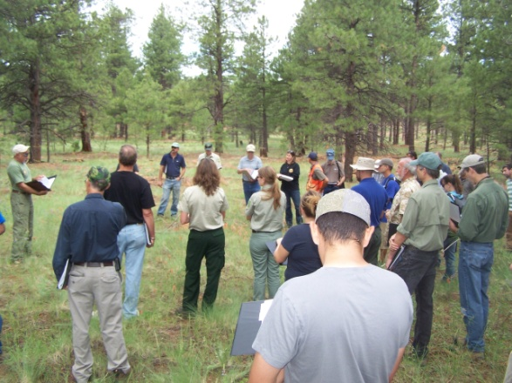
Why Flagstaff?
Relationship with Forest,
Strong awareness of Threat
History of City Leadership & Action
Long standing Partnerships
Timing
Favorable political environment

Slide 21
Why a Municipal Bond?
Benefits
Provides more immediate funds
Low administration costs
Planned retirement of older bonds
Challenges
Voter approval needed
Relationship to secondary property taxes

Slide 22
Process of Question #405
June 2011 – Santa Fe Workshop
March 2012 – Initial meeting with city staff
April-June 2012 – Development of measure by city/community task force
July 2012 – City Council approved for inclusion on ballot
Aug-Oct 2012 – Public campaign

Slide 23
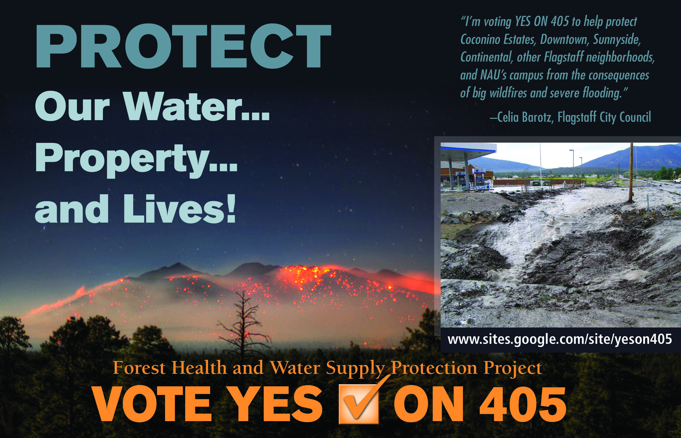
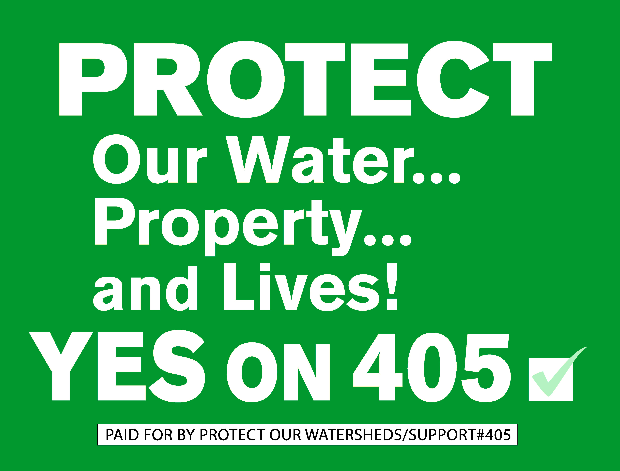
Campaign Methods
Presentations & Events
Post Card Mailers
Yard Signs
Media Outlets
Email Blasts
Website
City staff – Information
Yes on 405 - Advocate

Slide 24
Process of Question #405
March 2012 – Initial meeting with city staff
April-June 2012 – Development of measure by city/community task force
July 2012 – City Council approved for inclusion on Nov ballot
Aug-Oct 2012 – Public campaign
Nov 2012 – 74% Voter Approval

Slide 25
Issues Important to Supporters
74% of the voters
Reduce the impact of post-fire flooding
Protect city water resources
Invest now to avoid future costs
Flagstaff and USFS will use money efficiently
Reduce the risk of catastrophic fire
Investment will have clear outcomes
Over half believed their taxes would go UP!
County residents upset they could not vote YES!

Slide 26
Issues Important to Opposition
26% of the voters
My taxes are already too high
City and USFS will waste the money
I cannot afford to pay
Other issues: Not solution to water supply,
Opposed to thinning the forest,
Feds/industry should pay,
Threat overstated

Slide 27
Process of Question #405
March 2012 – Initial meeting with city staff
April-July 2012 – Development of measure by city/community task force
July 2012 – City Council approval for inclusion on ballot
Aug-Oct 2012 – Public campaign
Oct 2012 – 74% Voter Approval
Maintenance fees – Willingness to Pay study
Ongoing – Planning and implementation

Slide 28
Lessons Learned from #405
Spend the time – Work now, Act later
Build on history and success – Incremental sustained change
Talk, Do, Lead – Go all in, Be the “Spark Plug”
Partner Up – Become a known, reliable, contributor first
Connect –Link your issue and their needs

Slide 29
Lessons Learned from #405
Leverage – Allow others to contribute to your success
Timing – Better to wait than go too early, but when it’s right – JUMP
Campaign – Target your message to what they want, and to those who will decide the outcome
Plan – For catastrophic success!

Slide 30

Flagstaff Watershed Protection Project
“In Flagstaff, reality was more important than blame”
AZ Republic, Dec 2012

Slide 31
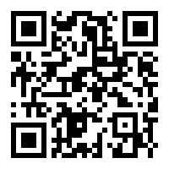
Flagstaff Watershed Protection Project
QUESTIONS?
www.flagstaffwatershedprotection.org
Mark Brehl Email: mbrehl@flagstaffaz.gov

