Slide 1
How can MAKE IN INDIA Happen??
Mr Arun Kumar Jagatramka
Chairman and Managing Director
Gujarat NRE Coke Ltd

Slide 2
Ease of Doing Business OR Ease of Extortions A Paradox that Industry faces

Slide 3
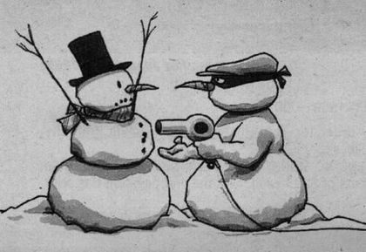
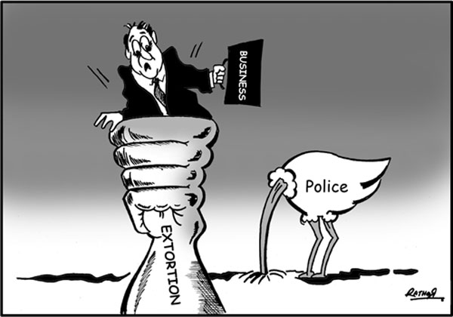
That Industries face on a regular basis
Politician

Slide 4
Extortion by local politicians
The local politicians find industry as an easy target for their benefit
They put pressure on industry for
Employment of their supporters as workers/employees
Use of vendors associated with them for any outsourced job like transportation, material handling and other contractual jobs
Or by acting on frivolous complains to extract benefit in cash or in kind

Slide 5
Industry viewed as a cash cow
Local politicians allow industry to be set up in their area only to milk them for their benefit
They at times act as local mafias
Any outsourced or contractual work if not awarded to their firms results into disruption of work
The firms associated to local politicians do not act professionally and are at times not commercially viable
The syndicate managed by the local politicians are against the interest of the business and industry

Slide 6
Extortion of enforcement officials
Industries are subject to extortion of enforcement officials like Factory inspector, Labour inspector, environment/pollution officials
The antediluvian laws of the land has many such provisions which can be referred by the enforcement agencies at their will to harass
No industry in the country can claim to be 100% compliant with all the provisions in various laws that govern us

Slide 7
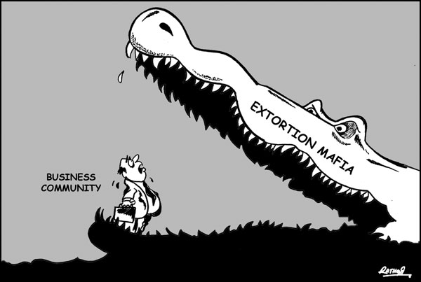
Bribes
Extortion
&
Business

Slide 8
License Raj gone but Inspector Raj still thrives
Visit of any of these inspectors would not conclude without a consideration
Any unsubstantiated complain is enough to raise a query culminating in a demand
Industry generally tend to acquiesce to such unlawful demand only to avoid further harassment
Excessive power in the hands of enforcement agencies are one of the greatest impediments to the ease of doing business

Slide 9
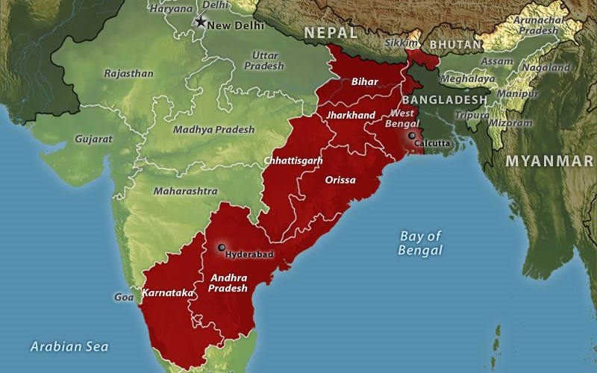
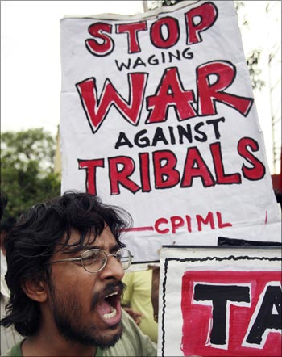
Political extortion leading to Naxalism in tribal areas
Naxalites thrive in tribal areas known for mining activity
Where there is mining there is conflict of tribal rights – a soft issue to gain popular support
Naxalites however do not see mining and allied industry as an enemy, but a source of illicit revenue
Industries operating in Naxalite prone area are forced to pay protection money to conduct business

Slide 10
Exploitation of Alienation
Naxalites in large parts of the country thrive on giving local populace the false sense of protection against land encroachment and by speaking for tribal rights
They have exploited the sense of abandonment among Adivasis caused by the apathy of administration since independence towards the development of large tribal lands, which still remain undeveloped and cut out from mainstream
They have thrived on the sense among Adivasis of being ‘have-nots’, as well as alienation and apathy of the disadvantaged rural poor

Slide 11
Extortion remains the backbone of Indian economy
Naxalites do extortion through use of arms and by operation that is unlawful
The extortion happening in non-naxalite area is different only by the kind of people and ideology of the person.
The difference is that here, the extortion is through people who vouch for democracy and rule of law, while Naxalites are those who do not believe in democracy and are anti-national
The extortion is the same. Industry is the victim and is forced to pay in both the instances

Slide 12
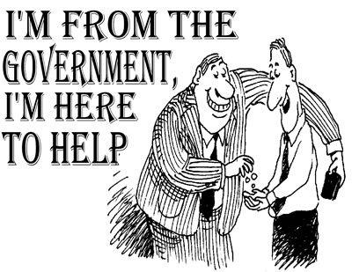
Is Doing Business a Crime in India??
Majority of businesses want to be Honest
But is there any business today who can vouch of being honest throughout?
Indian businesses are subjected to FORCED CORRUPTION
Corruption is today in our DNA

Slide 13
Law of majority
Corporate sector is forced to face corruption as a cost to do business in India
Democracy runs on the law of majority
Today, when the majority of businesses are labeled as corrupt, the entire country becomes corrupt
This majority should be given a chance to come clean and do a honest business

Slide 14
The steps being taken by the present government may cleanse the system for the generations to come…
But who would lift the current generation from the quagmire of corruption?
Would the age group of 30 to 60 + yeas be a lost generation??
Majority should be given a chance to come clean and run the business in honest manner
A quick fix police raj if comes into play in the name of fighting corruption and black money can not address the situation

Slide 15
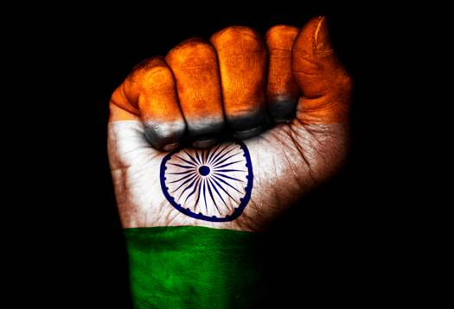
Need for a Radical Approach
Knee jerk reactions and criminality provisions would make all of us criminals – setting the vicious cycle of corruption once again
Need for systemic changes or a major surgery to rectify the corruption in the DNA
The government has the mandate and need to take a game changing decision
Or else India would continue to bleed In a semi-civil war scenario of corrupt fighting the non-corrupt

Slide 16
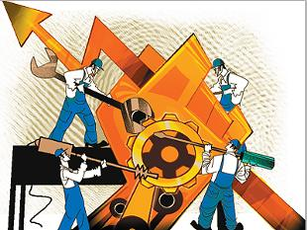
Revival of Industry

Slide 17
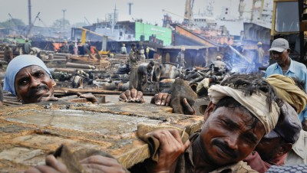
The Current State of Affairs
The last 6 years of recession has resulted in the economy bleeding
Policy paralysis for last 5 years has over burdened the industry
Government is facing an image crisis –
It is perceived as pro industry
Hence is hesitant to even take any step that is much required by the industry for revival, leave aside favor

Slide 18
The Current State of Affairs
Companies are making losses
India Inc's debt woes in the midst of a slowing domestic economy and a global recession have far-reaching consequences
Interest paid and payable is being piled up
About 60% of current debt virtually consist of interest paid by industry without earning in last 5 years

Slide 19
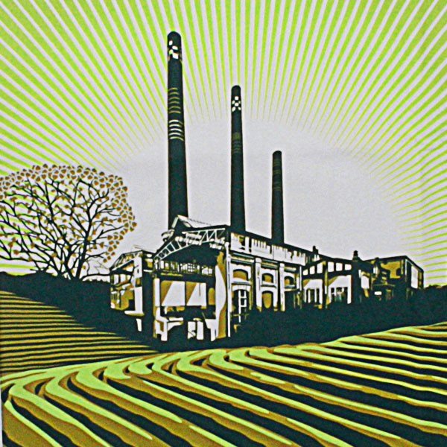
Prescription for Revival
We can not have a situation where a large chunk of India Inc become defaulters
Instead we need the industry to revive with reviving economy and pay back its debt
May explore one or two years of blanket moratorium with a chance for the industry to revive
Part of the interest amount paid may be ploughed back to industry to help it revive

Slide 20
Role of ASSOCHAM and its membership
The govt. has already stated its intention to scrap old and antiquated laws
We at ASSOCHAM need to identify the laws that impede in conducting an honest business
We need to present to the govt. the road map for reviving the ailing domestic industry
We need to publicise the means for the domestic industry to revive and participate more meaningfully in ‘Make in India’ in the changing economic landscape of the Nation

Slide 21
Focus on
Reviving the Domestic Industry
along with
Foreign Direct Investment
in an Environment where
Doing Business is Easy
would usher
MAKE IN INDIA

Slide 22
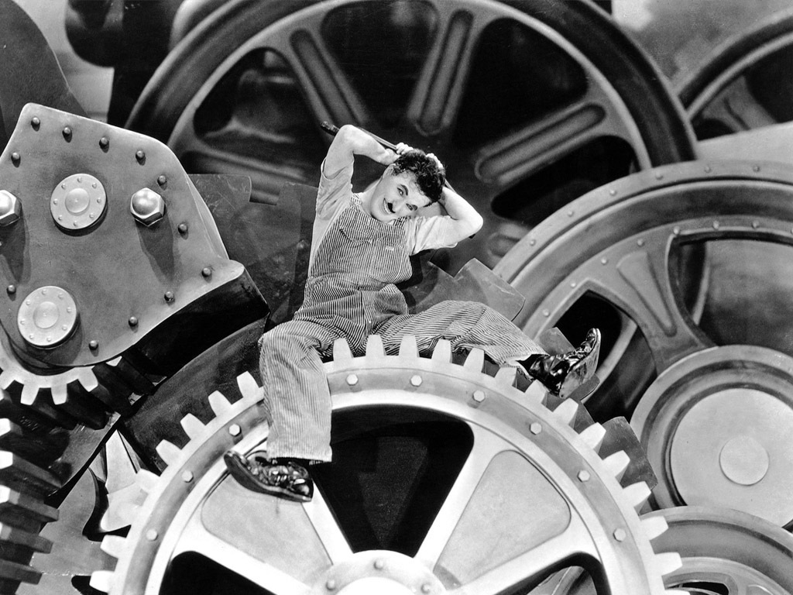
Thank You

